Slide 1
Automotive Transmissions
Shifting the Modern World into High Gear
Jacob Aljundi

Slide 2
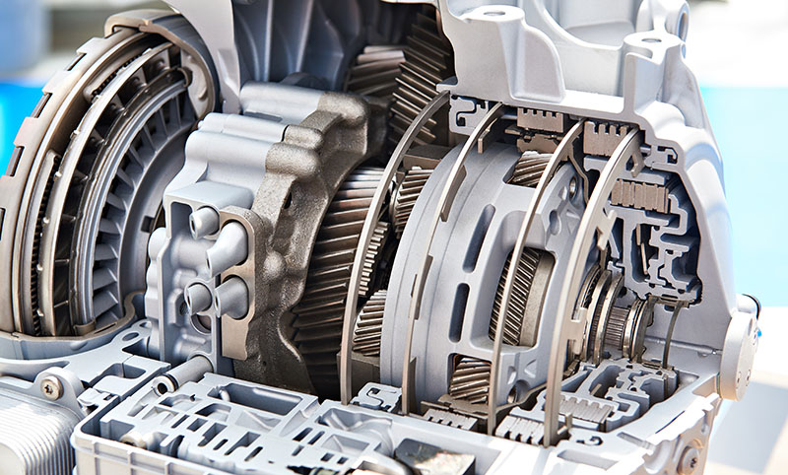
Neutral - Outline
Background
History
Gears
Types of Transmissions
Fun Facts

Slide 3
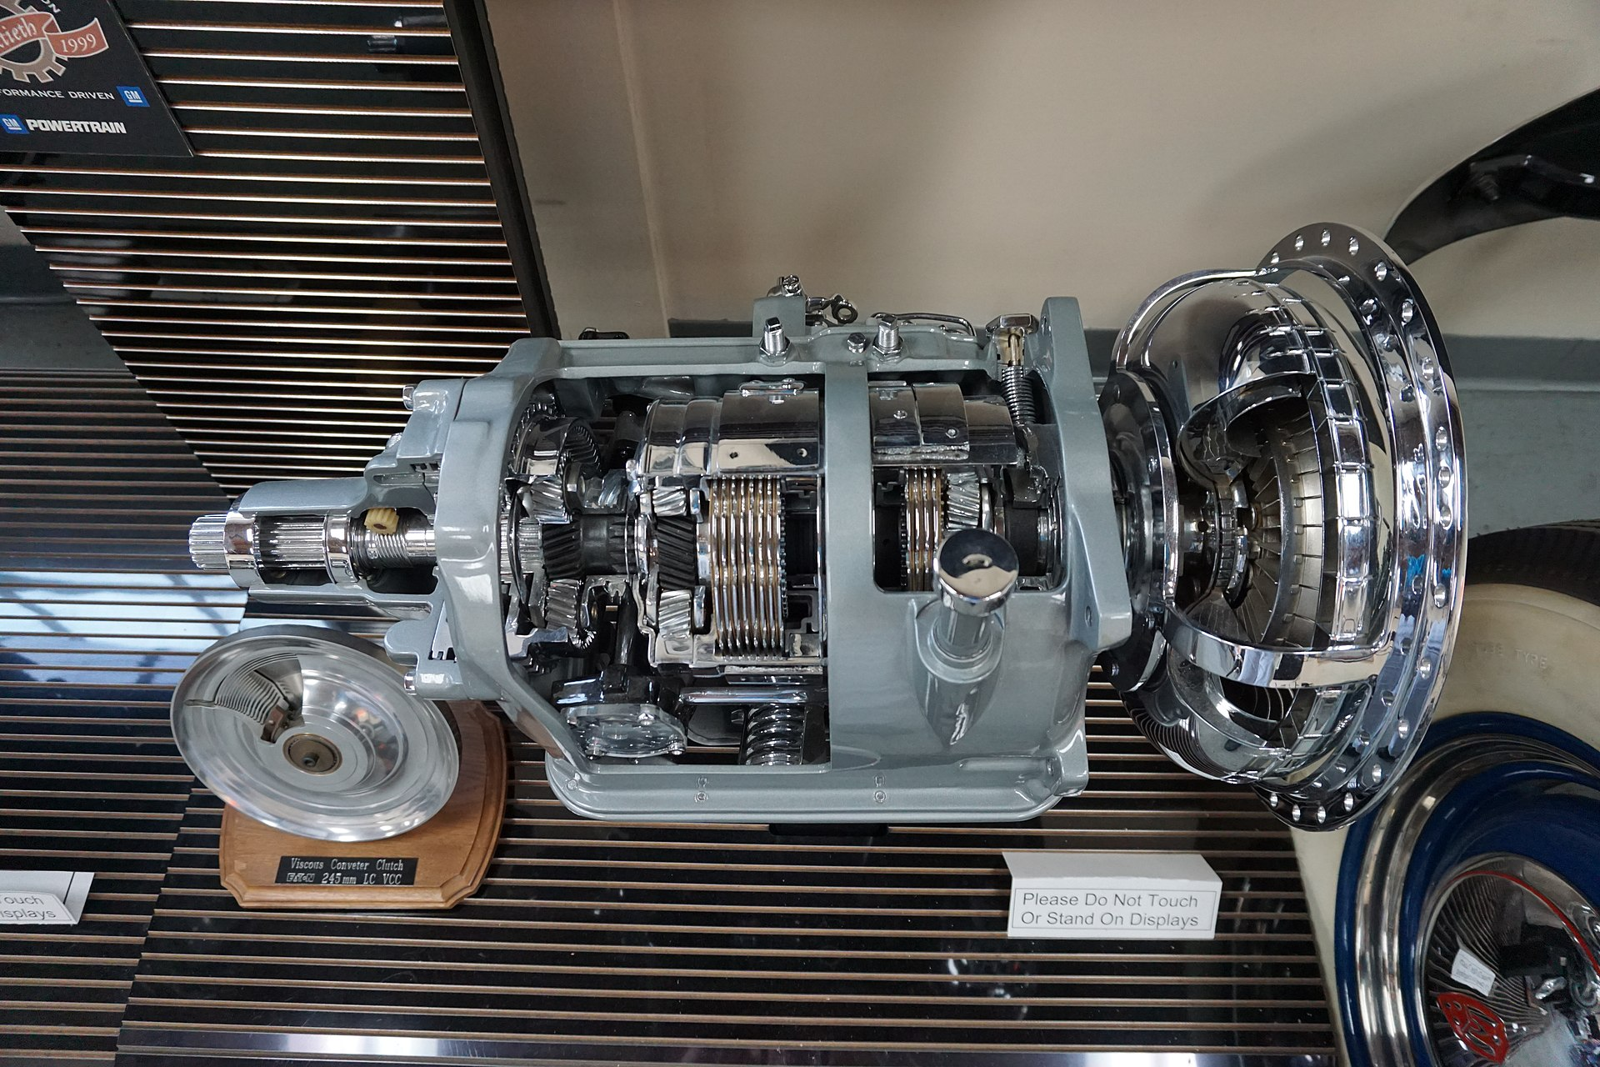
Reverse Gear - History
Converting power generated to useful work has been a necessity of civilization for centuries
The dawn of engines greatly increased the need for compact, mass producible forms of power transmission
Carl Benz patented the first concept of a motor driven passenger car in 1886
The first mass-produced, hydraulicly-driven automatic transmission arrived in 1939 with GM’s Hydra-matic

Slide 4
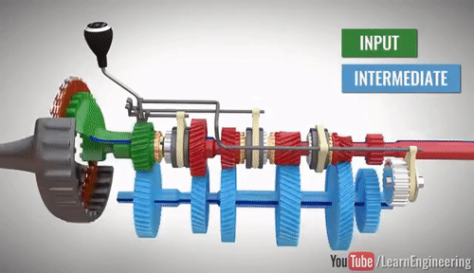
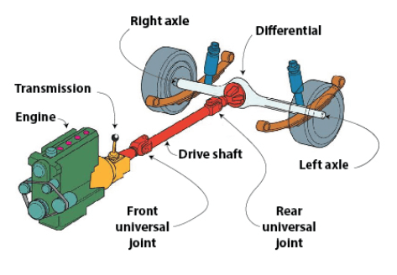
1st Gear - Background
The primary function of a transmission is to change direction of power and/or modify the incoming speed/torque
Used in a variety of different applications from windmills to bicycles
In vehicles, they transmit the power of the driveshaft from the motor to the driven wheels
In automotives, the transmission consists of the gearbox, differential, and drive/countershafts

Slide 5
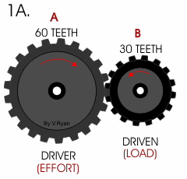
2nd Gear - Mechanical Advantage
Balance of angular velocity and torque
Matching two different size gears will provide different outputs
The ratio of gear diameters (mechanical advantage) determines the outputs
Examples: A high gear ratio of 1:2 means that for every revolution of the drive gear, the driven gear rotates twice. Resultant output is ½ the torque, but 2x the speed
ω – angular velocity
n – RPM
d – diameter
T - teeth

Slide 6
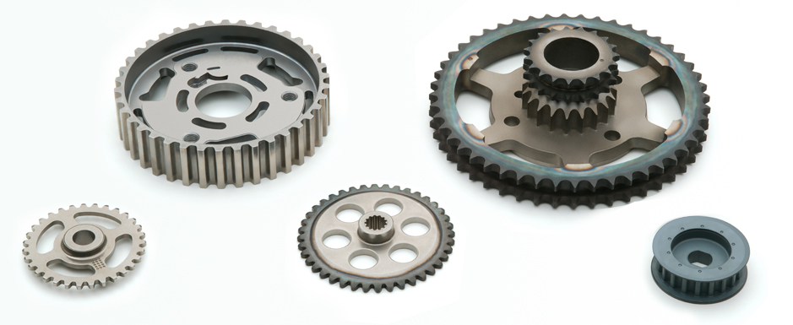
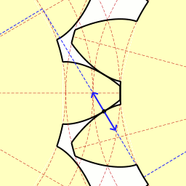
2nd Gear - How Gears Are Made
Gear Requirements:
High strength and wear resistance, low friction
Variety of manufacturing techniques
Machining, casting, forging, and sintering
Sintering provides the final shape of a range of geometries and functionally graded materials
Most gears are low and medium-carbon steel with various heat treatments
Involute shape
Allows for smooth power transmission without interruption during gear meshing

Slide 7
2nd Gear – How Gears Are Made

Slide 8
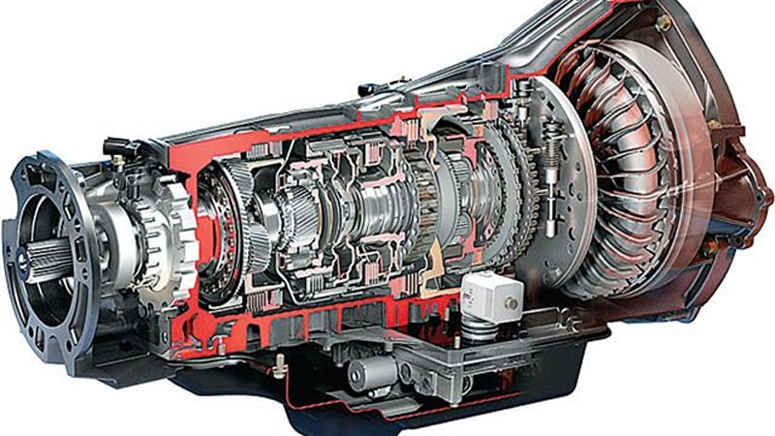
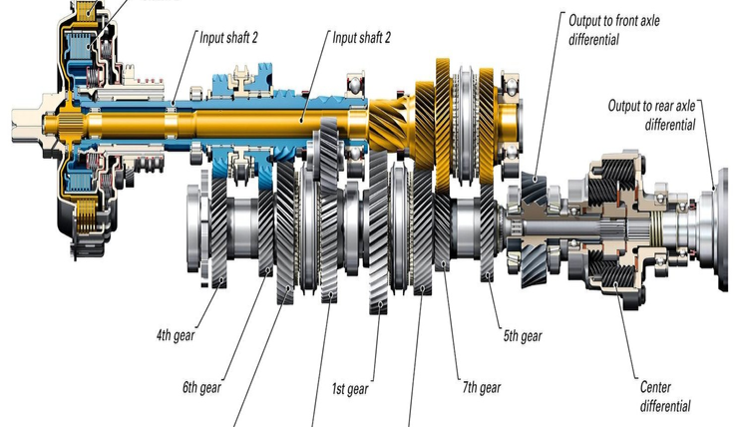
3rd Gear - Types of Transmissions
Manual
Automatic
Torque Converter
Dual Clutch
Continuously Variable
Non-synchronous

Slide 9
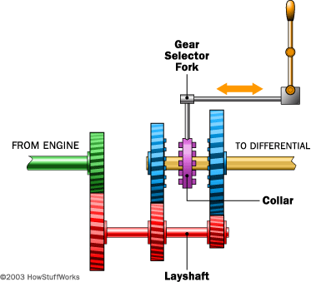
4th Gear - Manual
In a manual transmission, the gear selections are… manual
3-7 forward gears + reverse
Advantages:
Simpler design (<$)
Light weight
More control (more fun!)
Disadvantages:
Not as efficient or fast as modern automatics
Harder to learn
Can be destroyed by improper driving

Slide 10
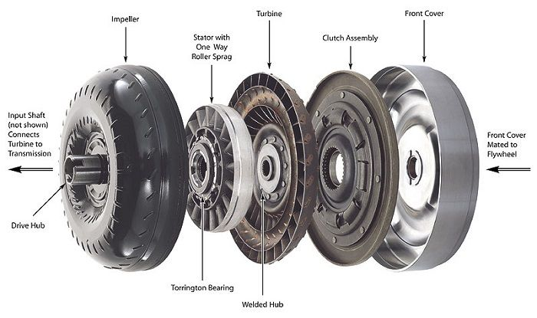
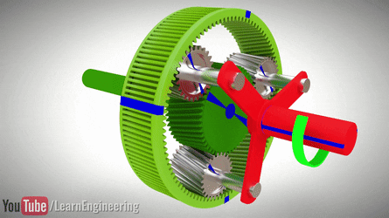
5th Gear - Torque Converter - Automatic
Automatic transmissions have gearing that is selected by the on-board computer
Connected to the engine with a torque converter that can multiply torque
Planetary Gears!
Pros:
Highly efficient with a large number of gears
Cons:
Heavy and expensive
Boring

Slide 11
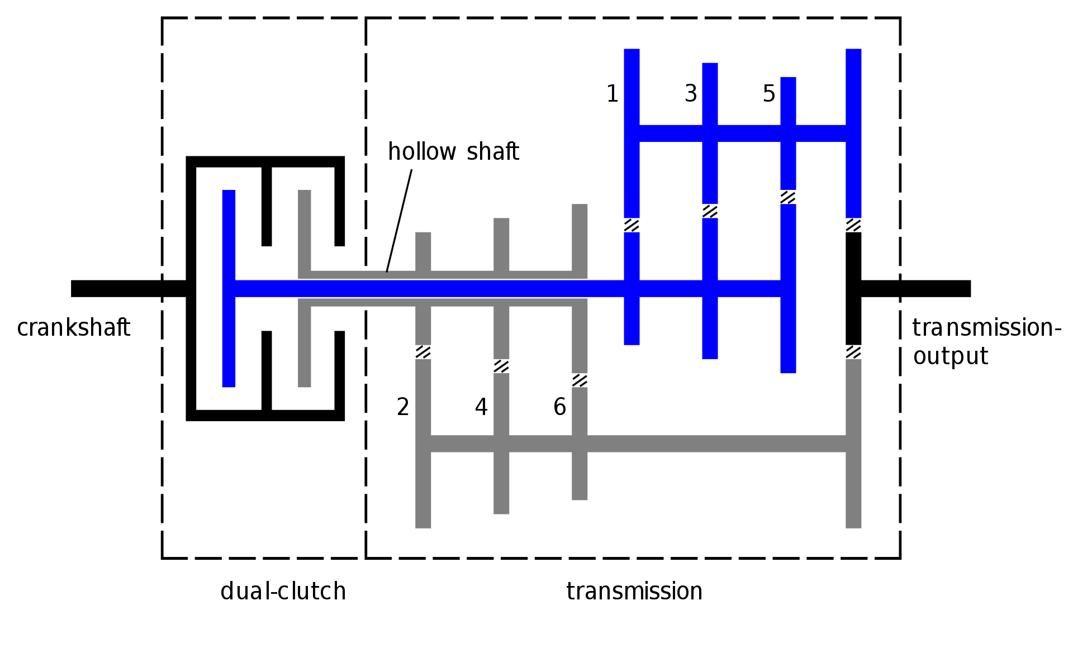
6th Gear - Dual Clutch (DCT) - Automatic
DCTs utilize two independent sets of gears and intermediate shafts to always have the next gear ready at the push of a paddle
Pros:
The best of both worlds, control and comfort
Blazing fast shifts (up to 0.08ms)
Cons:
Very heavy
Very expensive
Can only move up/down 1 gear at a time

Slide 12
Continuously Variable (CVT) - Automatic
We don’t talk about these

Slide 13
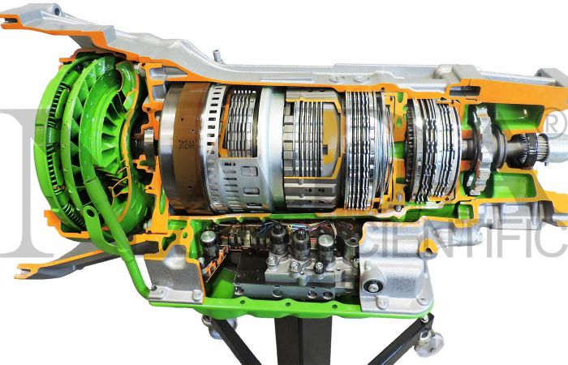
Overdrive - Fun Facts
According to a CBS survey in 2018 only 18% of Americans claim to know how to drive a manual transmission
A standard transmission costs between $1800-$3400
The average transmission consists of over 800 parts
Some semi-truck transmissions have up to 18 gears!

Slide 14
Thank You
Questions?

