Slide 1

Human eye and Lenses
Dog bone talk, Feb 9 2023

Slide 2
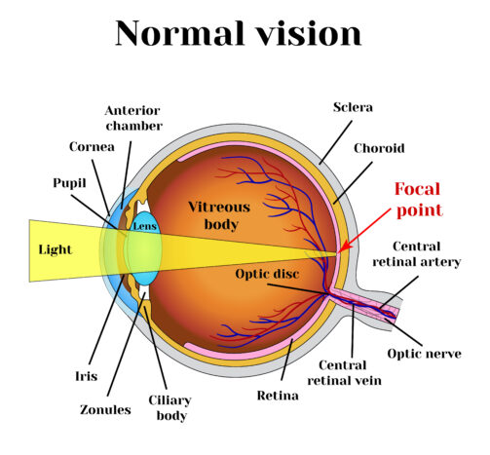
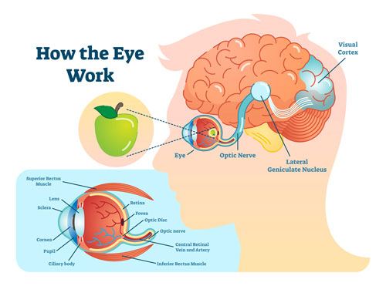
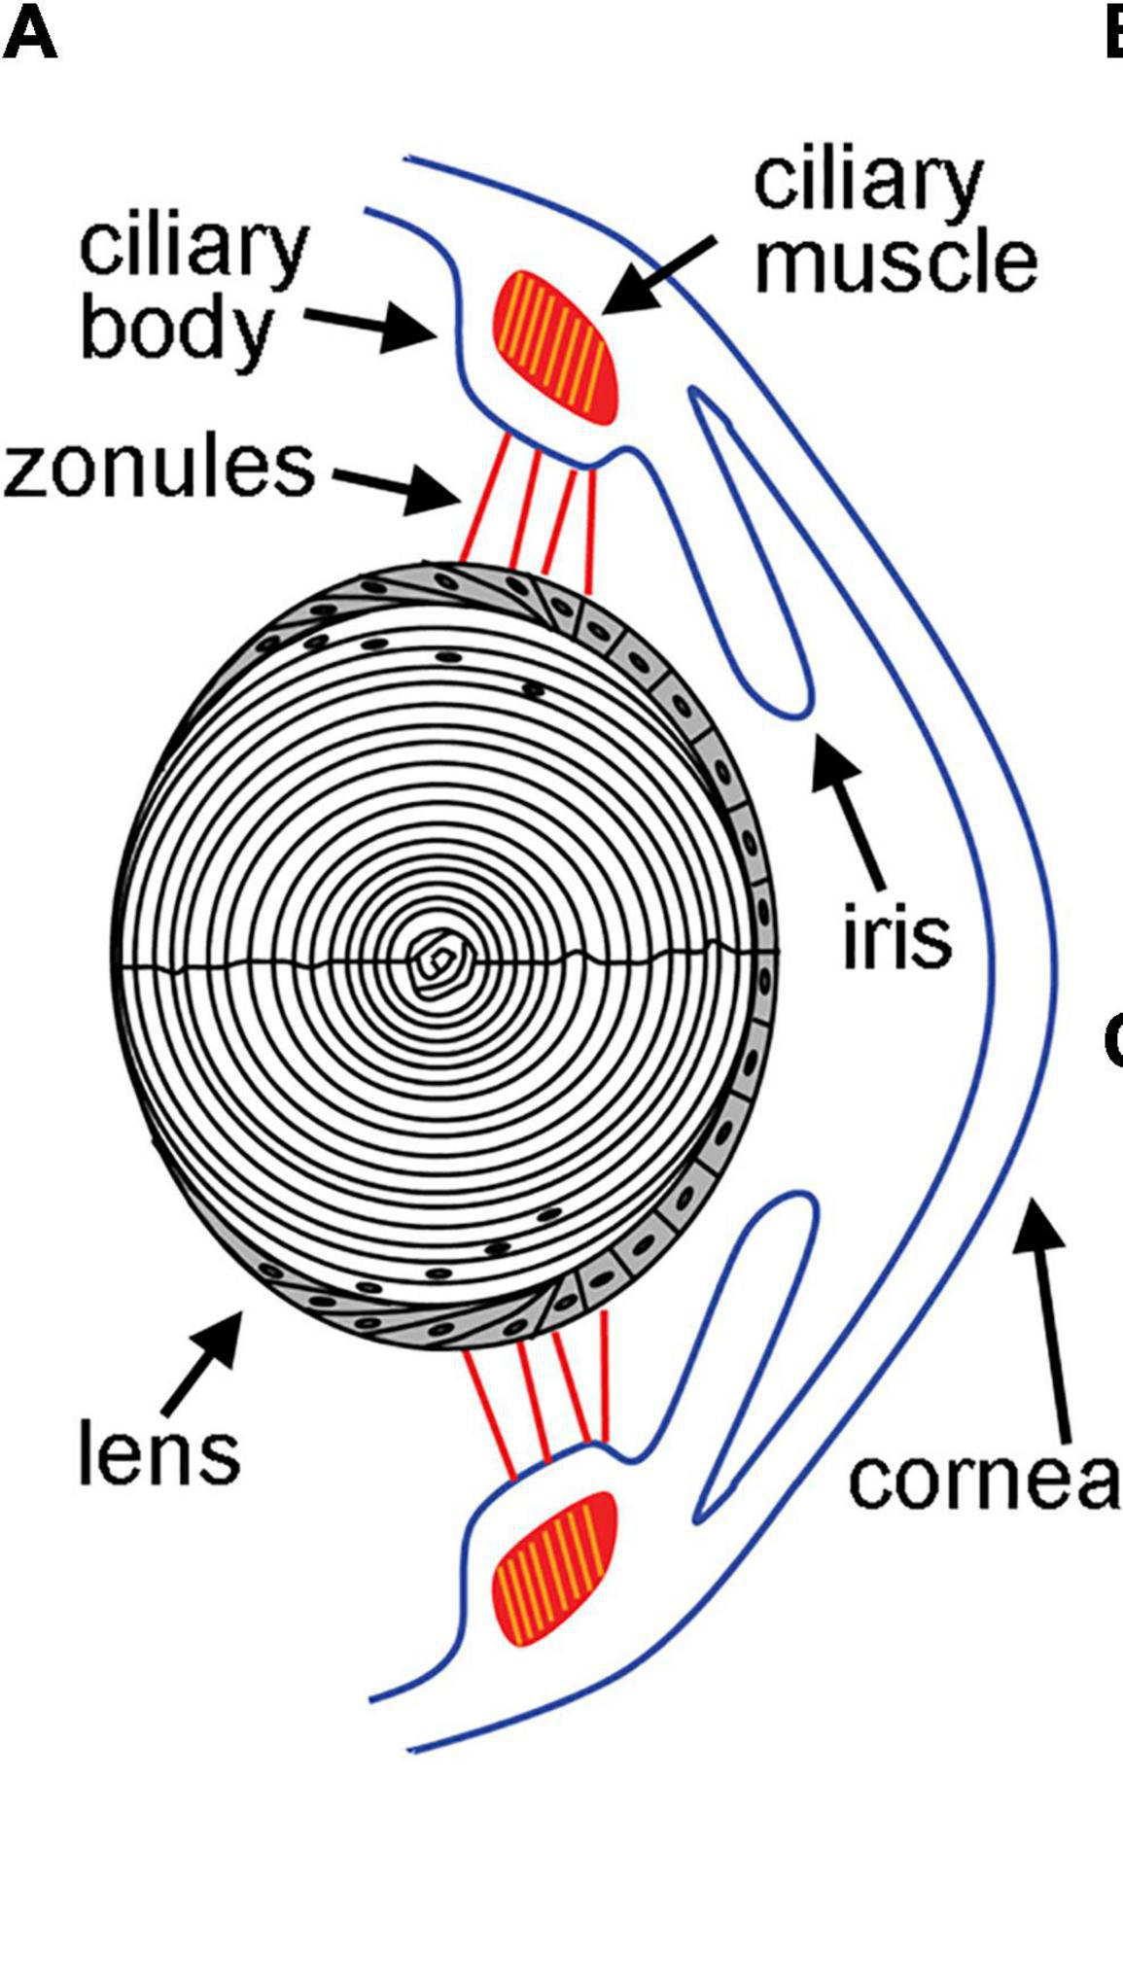
Eye anatomy
lens is a transparent proteins called crystallin
Notes:
People need glasses or contacts because of a common problem called refractive error, which blurs vision. There are four different types of refractive error: nearsightedness, farsightedness, astigmatism, and presbyopia. Nearsightedness and farsightedness are always mutually exclusive, but astigmatism and presbyopia may occur alone, with each other, and with nearsightedness or farsightedness. In order to understand refractive error, one needs to think of the eye as acting like a camera. The cornea (the transparent window forming the front of the eye) and the eye’s natural lens act like the lens of a camera to focus light onto the retina in the back of the eye. The retina functions like the film of a camera by receiving light images and translating them into electrical impulses that are transmitted to the brain and interpreted as vision. Patients who have no refractive error and do not need glasses or contacts to see perfectly have a perfect balance between the curvature of the front part of the eye (primarily the cornea) and the length of the eye, so that light images focus sharply on the retina. In the normal eye, close images can be focused on the retina by increasing the power of the natural lens through accommodation, which is the ability of the eye to change its focus between distant objects and near objects.
Nearsightedness
Nearsightedness (myopia) is the most common refractive error, affecting approximately 40% of the population of the United States. Nearsightedness occurs because the eye is too long or the cornea is too steep, resulting in blur (because images are brought into focus in front of the retina). Without corrective lenses, nearsighted people (in medical terminology, myopes) can see things up close but not far away. Myopia is treated surgically by decreasing the focusing power of the eye by flattening the cornea (LASIK/PRK) or by adding a negatively powered lens (ICL/IOL).
Farsightedness
Farsightedness (hyperopia) is also a common refractive error that requires glasses or contact lenses to correct. Farsightedness occurs because the eye is too short or the cornea is too flat, resulting in blur (because images are brought into focus behind the retina). When farsighted people have accommodation of their lens during their younger years, they can see up close and distantly without correction. As they age, hyperopes (people who are farsighted) first lose their reading vision (which takes the most accommodation), then their intermediate vision (computer) and, finally, their distance vision, requiring glasses or contacts. Because hyperopes maintain distance vision until they get older, the condition is called “farsightedness.” This familiar term for hyperopia is confusing, however, because hyperopes eventually lose their ability to see distance without glasses as they get older. Younger patients with significant hyperopia require glasses for far and near vision if their level of hyperopia is so high that their accommodative mechanism (zooming power of the natural lens) is not strong enough to compensate. Hyperopia is treated surgically by increasing the focusing power of the eye by steepening the cornea (LASIK/PRK) or adding a positively powered lens (ICL/IOL).
Astigmatism
Astigmatism is a refractive error that blurs vision at all distances because of two different curvatures of the cornea, causing two different images of light from a single light source, neither of which is in focus on the retina. Astigmatism can occur as an isolated visual challenge or in conjunction with nearsightedness or farsightedness. An eye without astigmatism has the same corneal curvature in each direction; to visualize this, think of a nonastigmatic cornea looking like a basketball cut in half. In contrast, an astigmatic cornea is shaped more like a football cut in half, with one direction steep,the other flat. Astigmatism is treated surgically by steepening the cornea in the flat axis and/or flattening the cornea in the steep axis (LASIK/PRK) or adding a lens that is positively powered in the flat axis (ICL/IOL).
Presbyopia
Presbyopia, is a refractive error that eventually plagues every human being who lives long enough to experience this age-related loss of zooming (or focusing) power in the lens, requiring reading glasses (for people with no other refractive error) or bifocals (in patients that have nearsightedness, farsightedness, or astigmatism). Presbyopia usually begins between the ages of forty-two to forty-seven because of the loss of accommodation. Eye doctors often joke that there are three facts of life: death, taxes, and presbyopia! Patients in their fifties, sixties, or seventies who claim that they have never needed glasses for distance or near visual acuity are still presbyopic, but they do not notice it, either because they have natural monovision (one eye set for distance, the other for near), or they have a low degree of nearsightedness in both eyes, which allows them to read; consequently, they have gotten used to the distance blur and do not realize that their distance is not perfect. Presbyopia and the loss of vision with age (due to farsightedness) both occur because of loss of accommodation, but they are distinct entities that are commonly confused. Presbyopia alone results strictly from the loss of accommodation in an eye that has a perfect balance between the curvature of the cornea and length of the eye and requires glasses for reading only; hyperopia results from an eye that is too short or a cornea that is too flat. In hyperopia, glasses are at first needed for reading (due to presbyopia), but eventually required for distance as well. Presbyopia is treated with reading glasses, monovisionLASIK/PRK or ICL or with presbyopic IOLs (accommodative or multi-focal).
biconvex structure

Slide 3
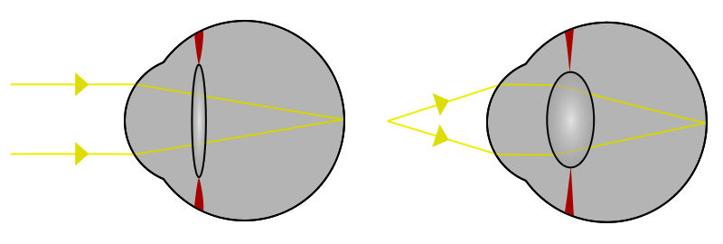
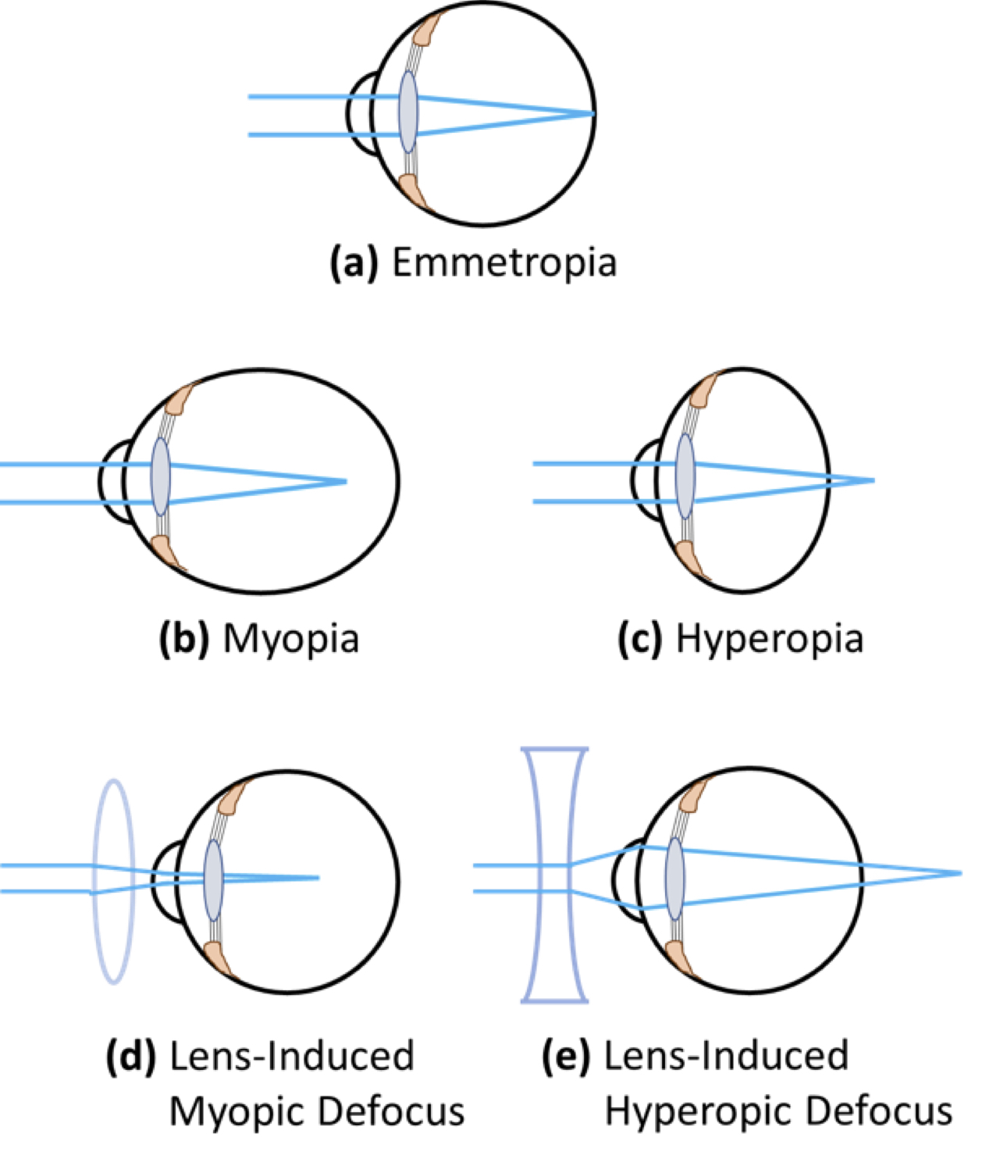
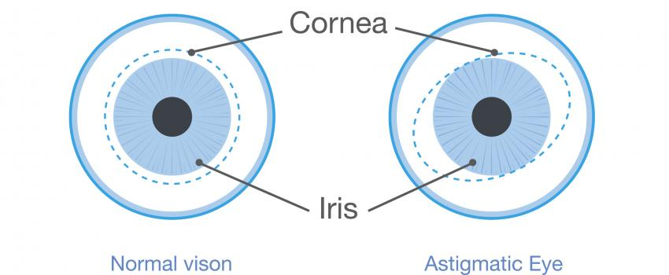
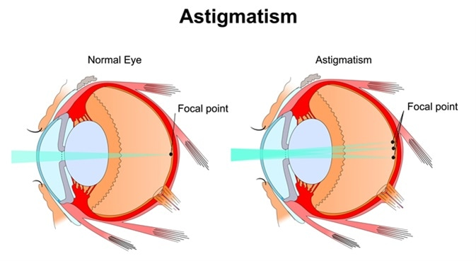
Why use the extra lens?
Look far → extended
Look far → bulged
-
Nearsightedness (myopia)
Farsightedness (hyperopia)
+
Astigmatism
º
cylindrical power
Notes:
People need glasses or contacts because of a common problem called refractive error, which blurs vision. There are four different types of refractive error: nearsightedness, farsightedness, astigmatism, and presbyopia. Nearsightedness and farsightedness are always mutually exclusive, but astigmatism and presbyopia may occur alone, with each other, and with nearsightedness or farsightedness. In order to understand refractive error, one needs to think of the eye as acting like a camera. The cornea (the transparent window forming the front of the eye) and the eye’s natural lens act like the lens of a camera to focus light onto the retina in the back of the eye. The retina functions like the film of a camera by receiving light images and translating them into electrical impulses that are transmitted to the brain and interpreted as vision. Patients who have no refractive error and do not need glasses or contacts to see perfectly have a perfect balance between the curvature of the front part of the eye (primarily the cornea) and the length of the eye, so that light images focus sharply on the retina. In the normal eye, close images can be focused on the retina by increasing the power of the natural lens through accommodation, which is the ability of the eye to change its focus between distant objects and near objects.
Nearsightedness
Nearsightedness (myopia) is the most common refractive error, affecting approximately 40% of the population of the United States. Nearsightedness occurs because the eye is too long or the cornea is too steep, resulting in blur (because images are brought into focus in front of the retina). Without corrective lenses, nearsighted people (in medical terminology, myopes) can see things up close but not far away. Myopia is treated surgically by decreasing the focusing power of the eye by flattening the cornea (LASIK/PRK) or by adding a negatively powered lens (ICL/IOL).
Farsightedness
Farsightedness (hyperopia) is also a common refractive error that requires glasses or contact lenses to correct. Farsightedness occurs because the eye is too short or the cornea is too flat, resulting in blur (because images are brought into focus behind the retina). When farsighted people have accommodation of their lens during their younger years, they can see up close and distantly without correction. As they age, hyperopes (people who are farsighted) first lose their reading vision (which takes the most accommodation), then their intermediate vision (computer) and, finally, their distance vision, requiring glasses or contacts. Because hyperopes maintain distance vision until they get older, the condition is called “farsightedness.” This familiar term for hyperopia is confusing, however, because hyperopes eventually lose their ability to see distance without glasses as they get older. Younger patients with significant hyperopia require glasses for far and near vision if their level of hyperopia is so high that their accommodative mechanism (zooming power of the natural lens) is not strong enough to compensate. Hyperopia is treated surgically by increasing the focusing power of the eye by steepening the cornea (LASIK/PRK) or adding a positively powered lens (ICL/IOL).
Astigmatism
Astigmatism is a refractive error that blurs vision at all distances because of two different curvatures of the cornea, causing two different images of light from a single light source, neither of which is in focus on the retina. Astigmatism can occur as an isolated visual challenge or in conjunction with nearsightedness or farsightedness. An eye without astigmatism has the same corneal curvature in each direction; to visualize this, think of a nonastigmatic cornea looking like a basketball cut in half. In contrast, an astigmatic cornea is shaped more like a football cut in half, with one direction steep,the other flat. Astigmatism is treated surgically by steepening the cornea in the flat axis and/or flattening the cornea in the steep axis (LASIK/PRK) or adding a lens that is positively powered in the flat axis (ICL/IOL).
Presbyopia
Presbyopia, is a refractive error that eventually plagues every human being who lives long enough to experience this age-related loss of zooming (or focusing) power in the lens, requiring reading glasses (for people with no other refractive error) or bifocals (in patients that have nearsightedness, farsightedness, or astigmatism). Presbyopia usually begins between the ages of forty-two to forty-seven because of the loss of accommodation. Eye doctors often joke that there are three facts of life: death, taxes, and presbyopia! Patients in their fifties, sixties, or seventies who claim that they have never needed glasses for distance or near visual acuity are still presbyopic, but they do not notice it, either because they have natural monovision (one eye set for distance, the other for near), or they have a low degree of nearsightedness in both eyes, which allows them to read; consequently, they have gotten used to the distance blur and do not realize that their distance is not perfect. Presbyopia and the loss of vision with age (due to farsightedness) both occur because of loss of accommodation, but they are distinct entities that are commonly confused. Presbyopia alone results strictly from the loss of accommodation in an eye that has a perfect balance between the curvature of the cornea and length of the eye and requires glasses for reading only; hyperopia results from an eye that is too short or a cornea that is too flat. In hyperopia, glasses are at first needed for reading (due to presbyopia), but eventually required for distance as well. Presbyopia is treated with reading glasses, monovisionLASIK/PRK or ICL or with presbyopic IOLs (accommodative or multi-focal).
Astigmatism
https://www.mayoclinic.org/diseases-conditions/astigmatism/symptoms-causes/syc-20353835#:~:text=Astigmatism%20(uh%2DSTIG%2Dmuh,the%20eye%20has%20mismatched%20curves.

Slide 4
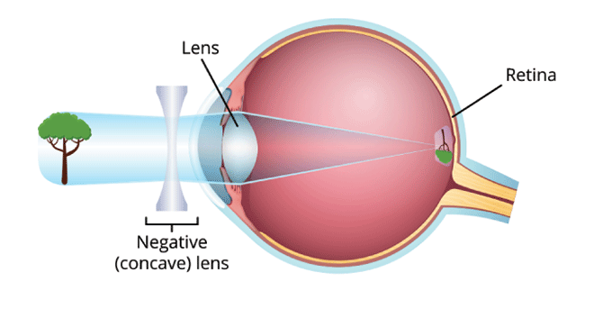
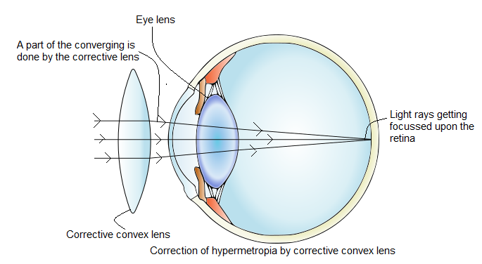
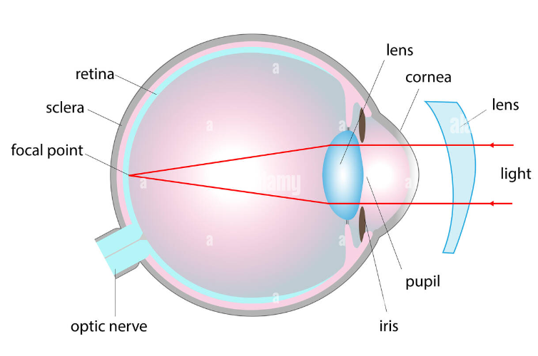
Corrections?
-
Farsightedness (hyperopia)
Astigmatism
Nearsightedness (myopia)
+
º
Convex; convergent lens
corrects hyperopia
Combination of spherical
and cylindrical
Concave, divergent lens corrects Myopia

Slide 5
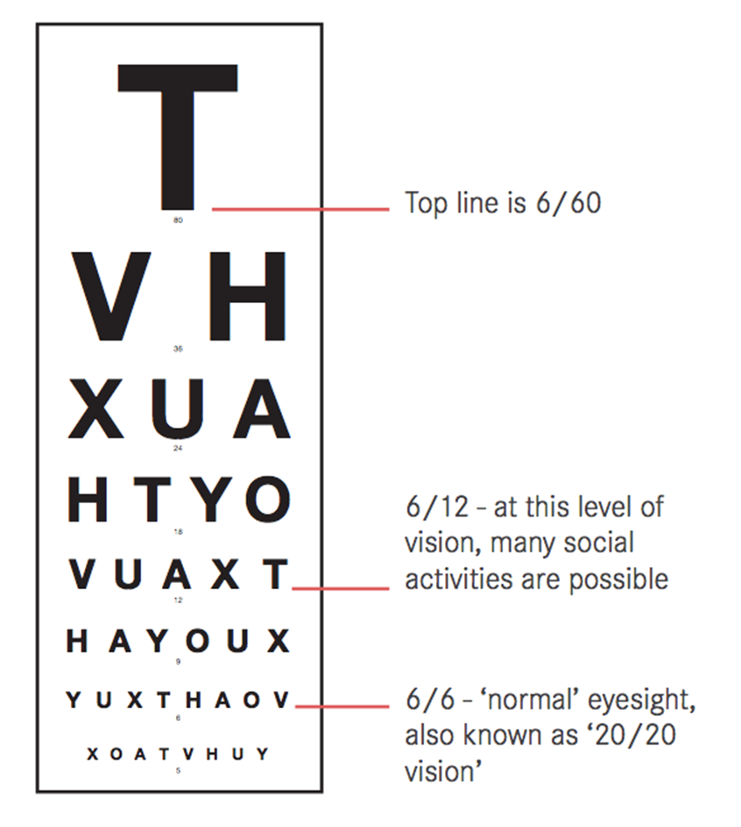
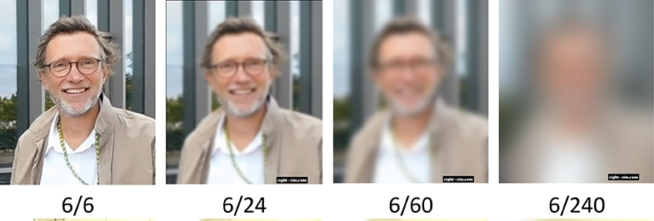
6/6 or (20’/20’) Vision
6/6: = 6 meters/6 meters
20/20= 20 feet/20 feet
6/6: A person sees at 6 meters with the same clarity as a person with perfect vision sees at 6 meters.
6/20: A person sees at 6 meters with the same clarity as a person with perfect vision sees at 20 meters.

Slide 6
Eye power!
Diopter (D): is a unit of measurement of the optical power of a lens or curved mirror
Far and Near sightedness are corrected by spherical:
For example,
+1.5 D means you have hypermetropia with 1.5 eye power.
-2.5 D represents myopia with 2.5 eye power
Magnification:
e.g. 3 diopter lens = 3/4 + 1 = 1.75x
Therefore, objects viewed through a 3 diopter lens will appear 175% bigger(+)or smaller(-) than normal
Astigmatism is corrected by cylindrical and axis
0-180°

Slide 7
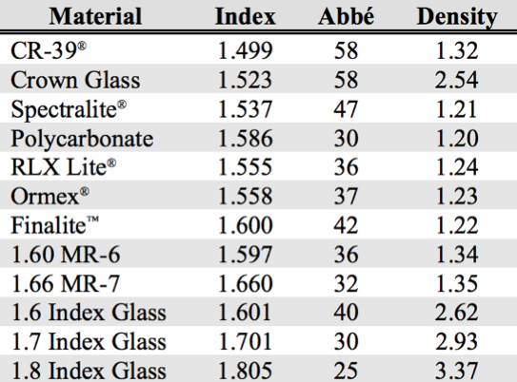
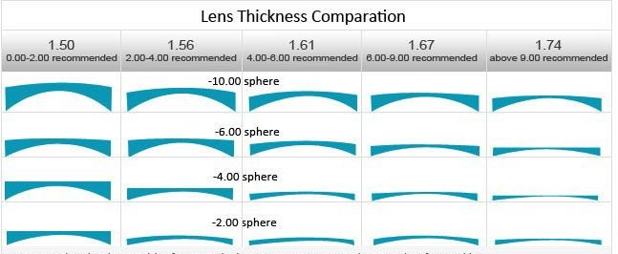
How to choose refractory index of a lens?
Diopter
Upto 2
>2
high reflective index lenses are designed to bend light more efficiently — leading to thinner and lighter lenses
High reflective index means high optical density
Human eye lens is ~ 10 mm in dia. and has a ref index of 1.3-1.4
Notes:
Size of eye lens:
https://www.cs.mcgill.ca/~rwest/wikispeedia/wpcd/wp/l/Lens_%2528anatomy%2529.htm#:~:text=The%20lens%20is%20made%20of,structural%20role%20in%20the%20lens.
Optical vs physical density
https://www.physicsclassroom.com/class/refrn/Lesson-1/Optical-Density-and-Light-Speed#:~:text=The%20physical%20density%20of%20a,as%20a%20new%20electromagnetic%20disturbance.

Slide 8
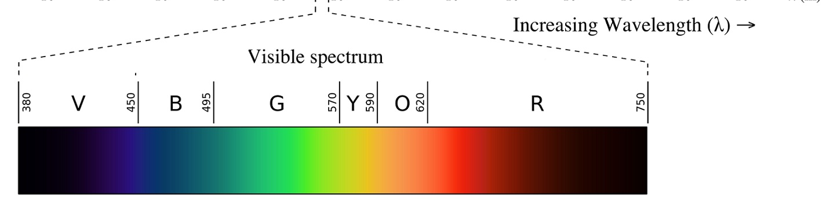
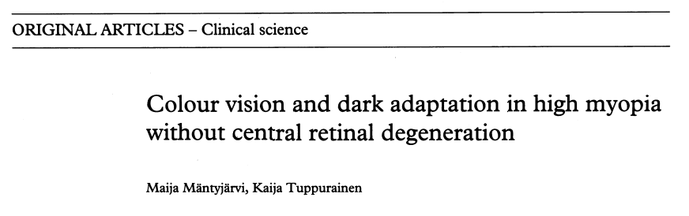
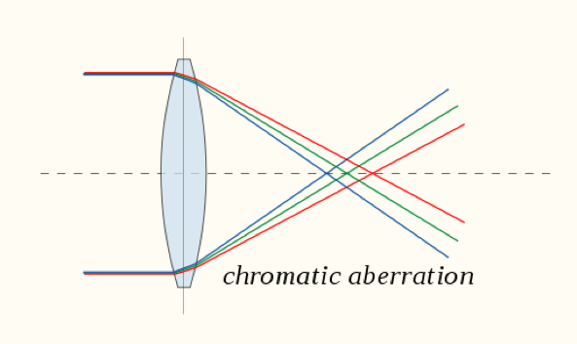
Chromatic dispersion
Notes:
https://bjo.bmj.com/content/bjophthalmol/79/2/105.full.pdf

Slide 9
Hello
Hello
Hello
Hello
Hello
Hello
Hello
Hello
Hello
Hello
Hello
Hello

Slide 10
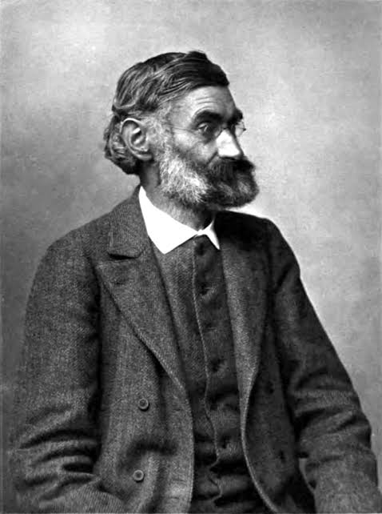
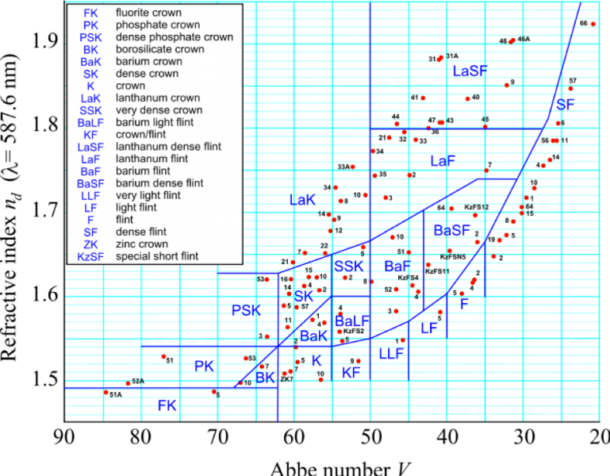
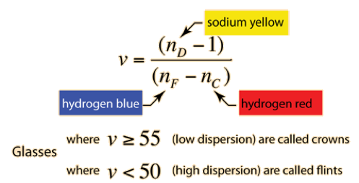
Crown glass Vs Flint glass; Abee number
Ernest Abbe

Slide 11
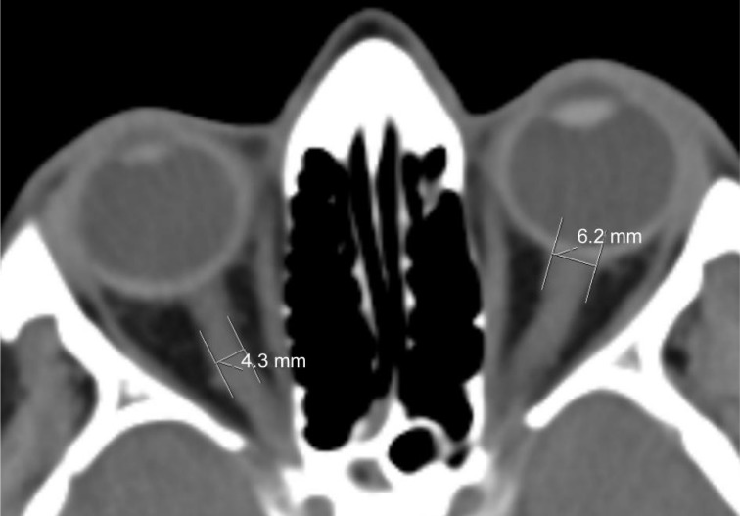
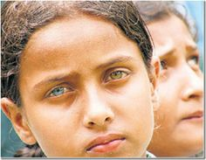
Fun Quiz
Q. How many fibers does the optic never have?
National Library of Medicine
~1.2 Million (~2-3 nm dia. fibers)
Q. What is the processing power of brain in terms of image processing?
13-100 milliSeconds
Q. Where does the color of iris come from?
Melanin- Genes matter for eye color! chromosome 15, genes OCA2 and HERC2
Q. Can iris have different colors on each eye?
Optic nerve sheath diameters as measured by CT in transverse projection
Yes, Heterochromia (natural or acquired)
American Academy of Ophthalmology
Q. What Is the power of an average human eye?
4.75 (15 DIOPTRE) from lens- total eye (40-60 DIOPTRE)
= one can see as close as 1-3/4”
10 Diopter above 25 years
= one can see as close as 4”
Notes:
Nerve endings
https://www.gangareyenation.com/how-your-eyes-work/
Iris
https://medlineplus.gov/genetics/understanding/traits/eyecolor/#:~:text=A%20person's%20eye%20color%20results,light%20blue%20to%20dark%20brown.
Two Iris colors
https://www.aao.org/eye-health/diseases/what-is-heterochromia#:~:text=Heterochromia%20is%20when%20a%20person's,this%20is%20called%20partial%20heterochromia.
Celebrities with heterochromia
https://www.goodhousekeeping.com/beauty/g2844/celebrities-with-heterochromia-different-colored-eyes/

Slide 12
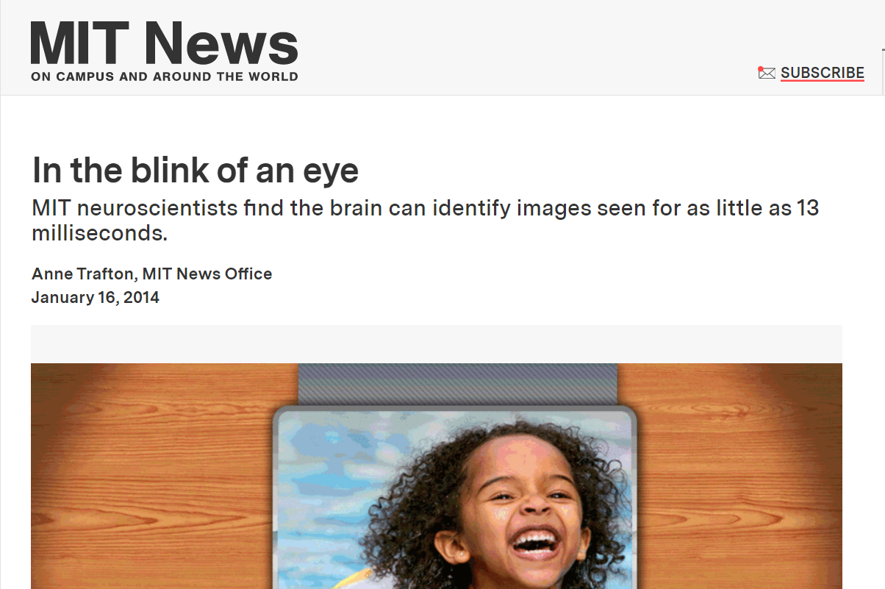
Link

