Slide 1
LEGO
Maddy Selby
Dogbone of the Week
March 9, 2023

Slide 2
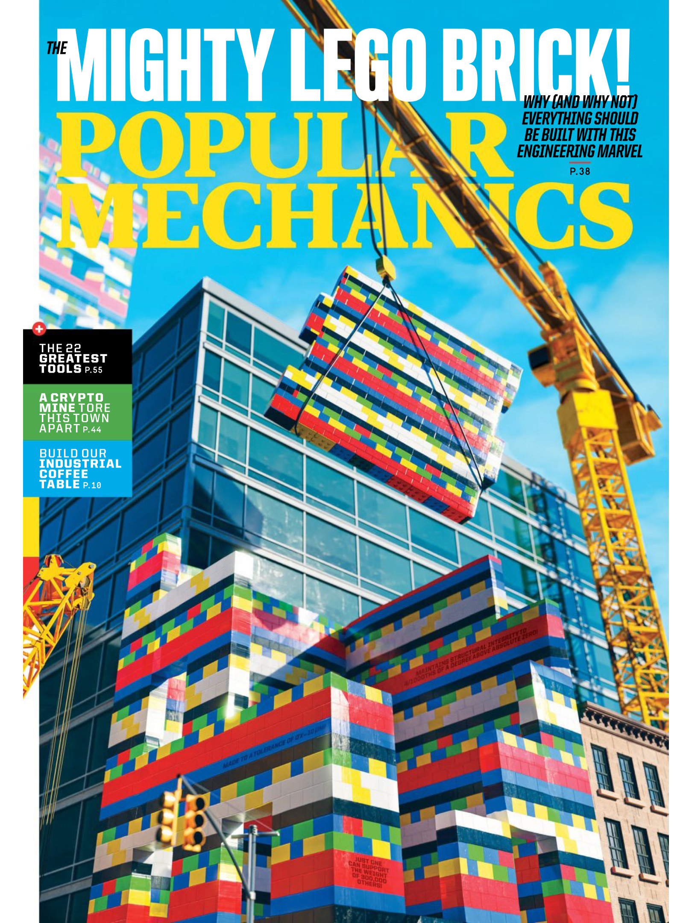
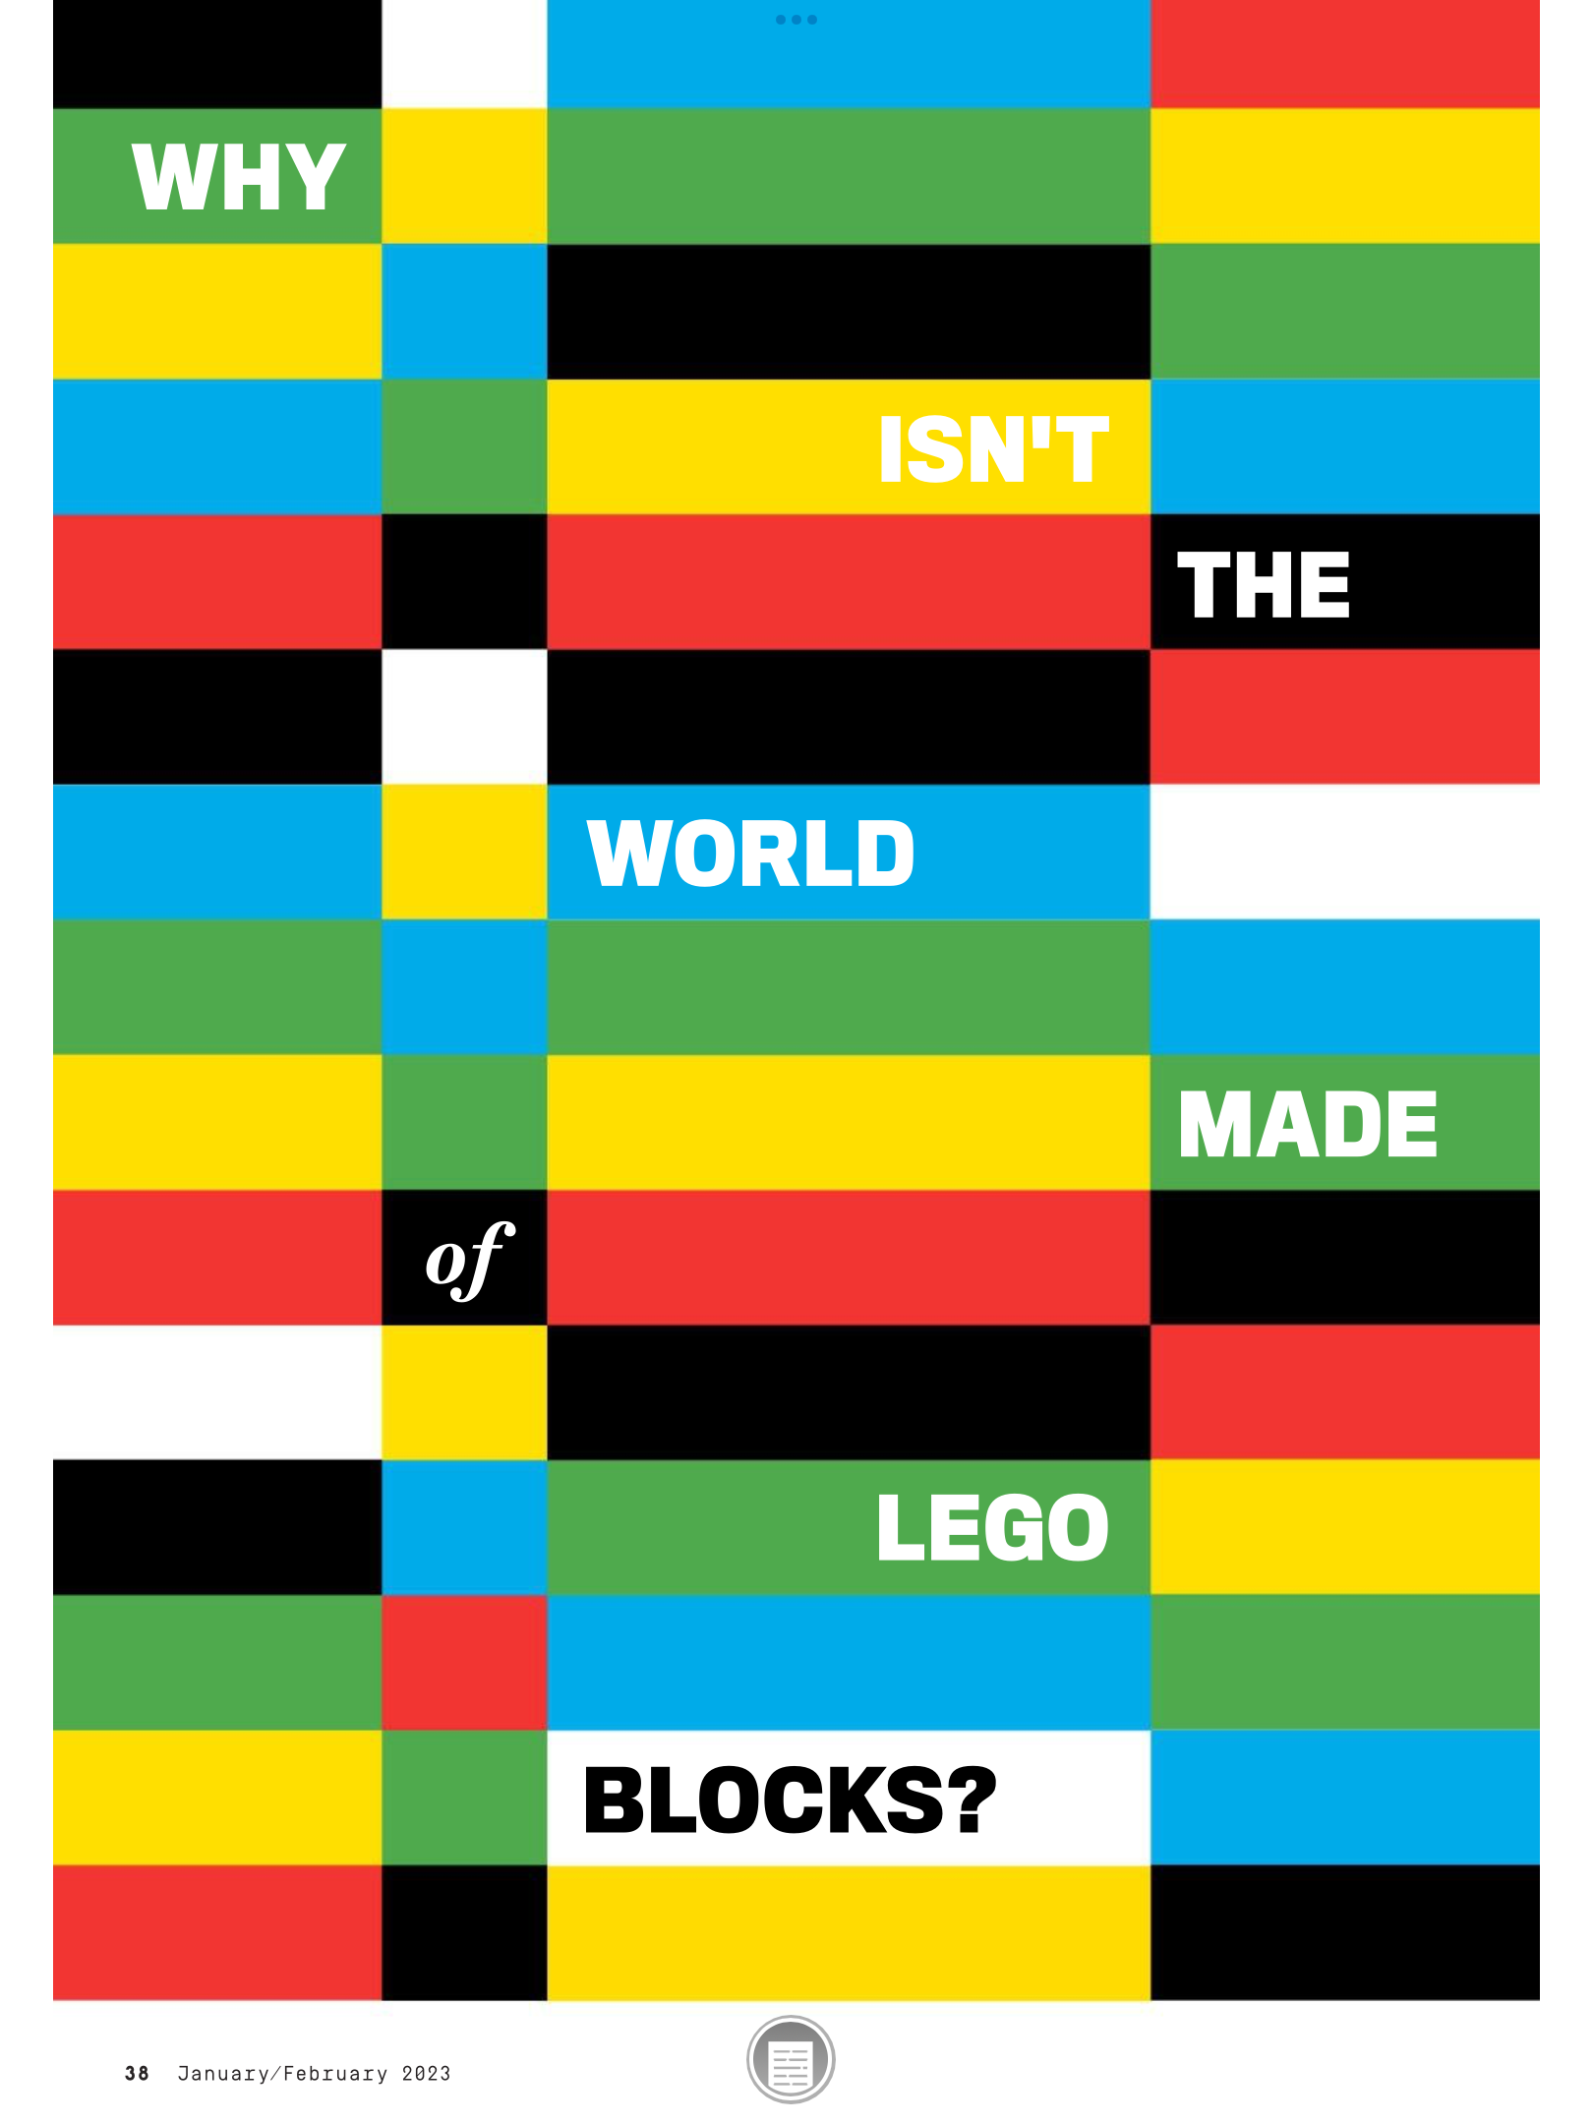

Slide 3
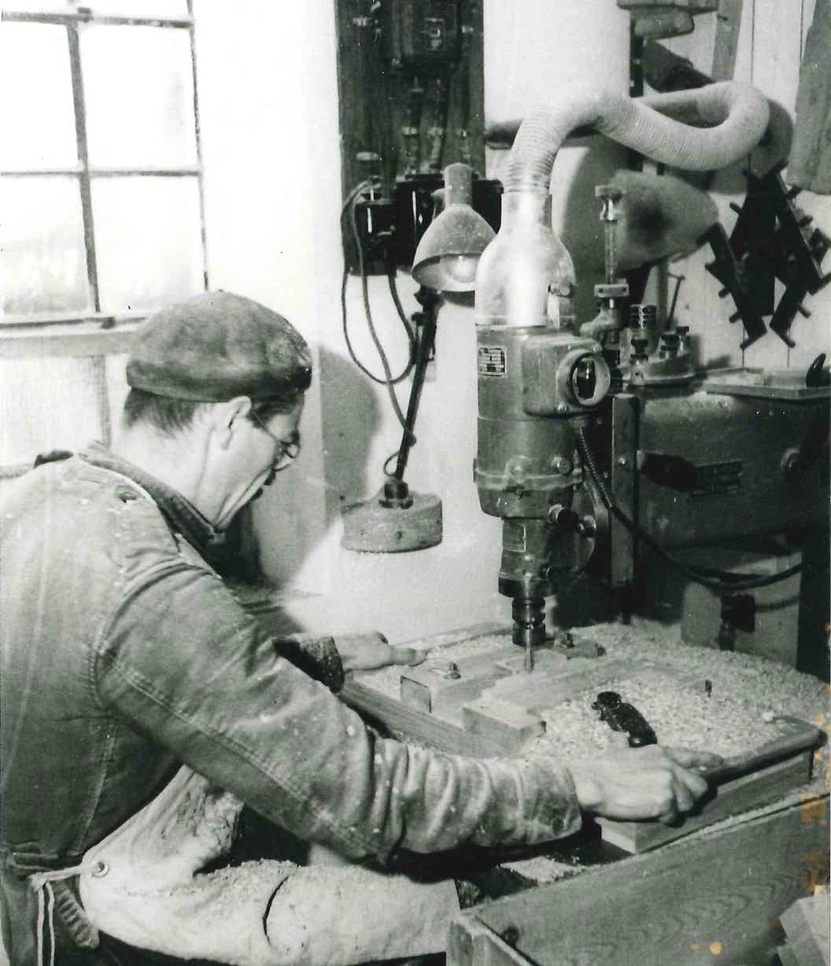
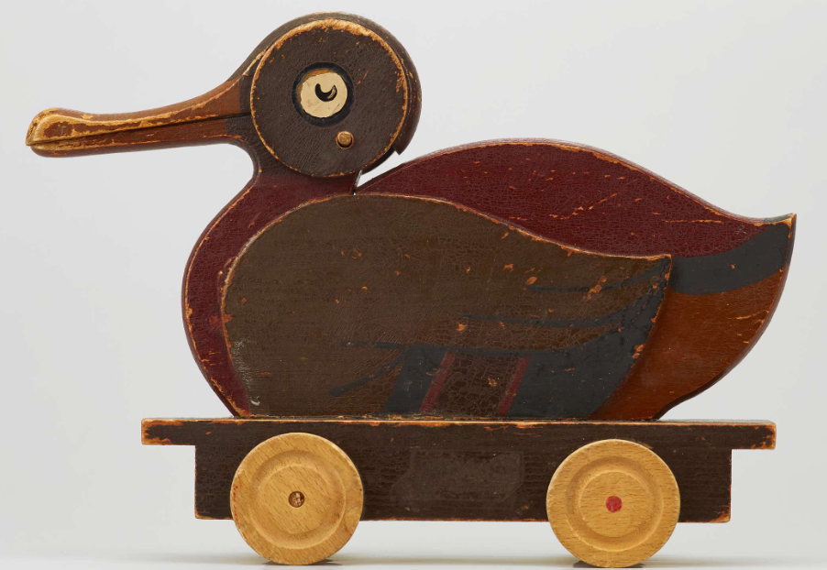
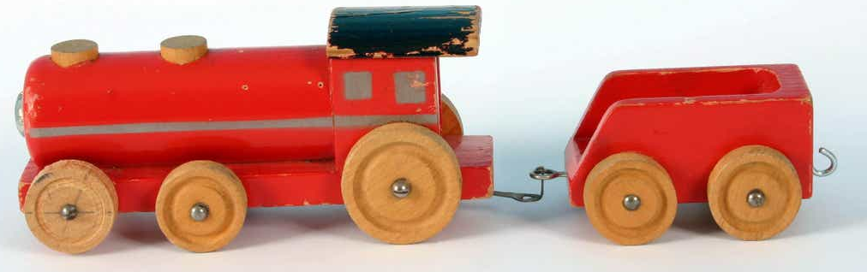
LEg GOdt
1932 – Ole Kirk Kristiansen makes wooden toys in Denmark
Mid-1930s – they buy a milling machine!
1936 – company name meaning “play well”
Notes:
Cars, airplanes, yoyos, ladders ironing boards, etc

Slide 4
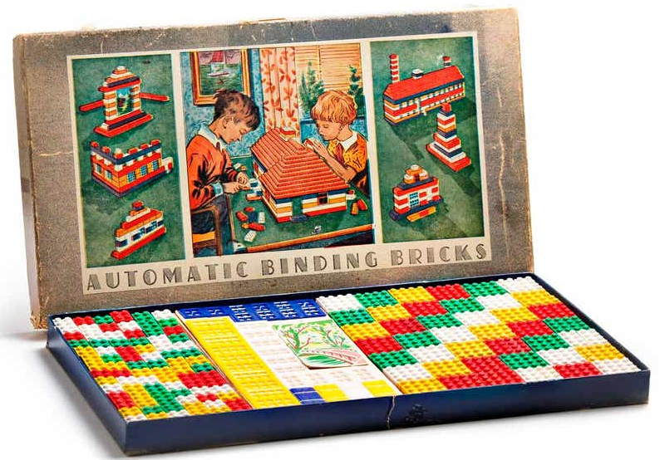
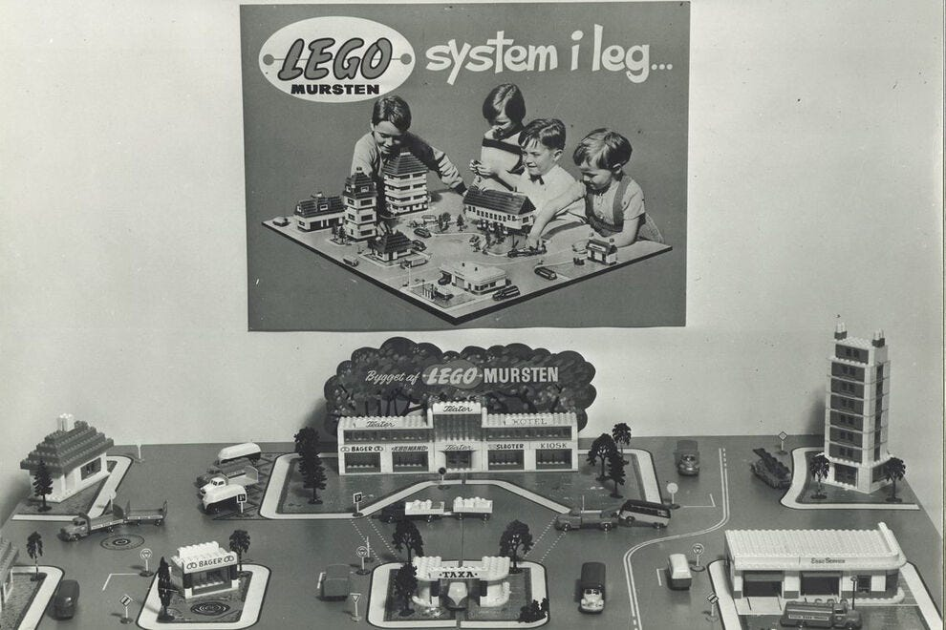
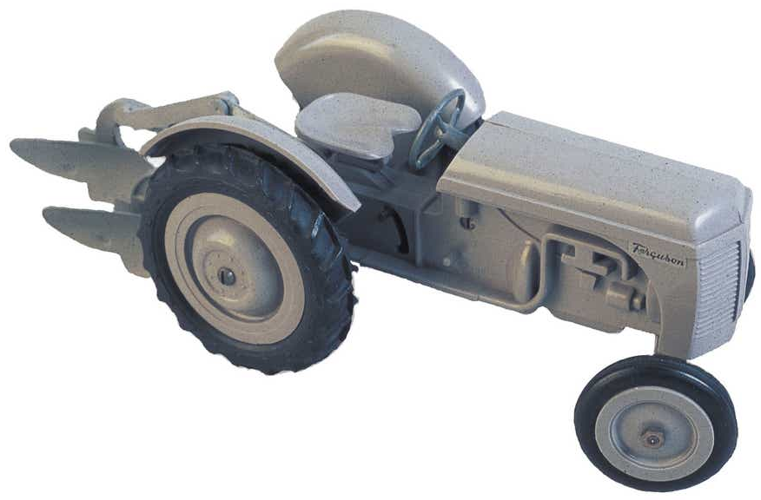
Moving to Plastic
1946 – first plastic injection moulding machine
1949 – Automatic Binding Bricks
Poor interlocking quality
1951 – Ferguson Tractor is top selling plastic toy
1955 – LEGO System in Play
1958 – LEGO System is the only plastic toy

Slide 5
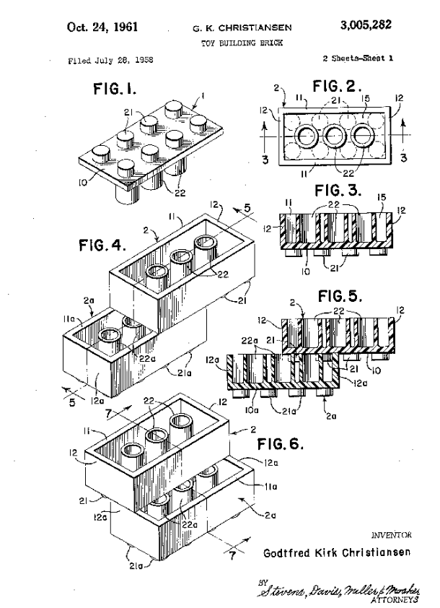
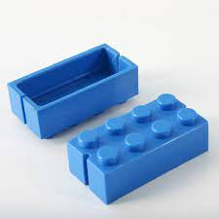
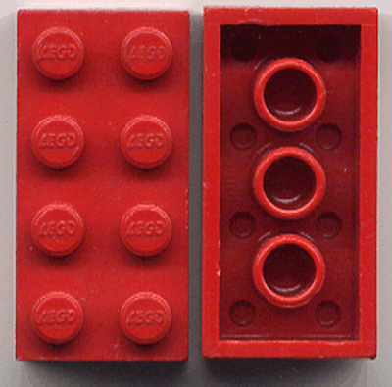
The real LEGO bricks
LEGO bricks patent filed in 1958
Stud and tube coupling

Slide 6
Materials
Originally cellulose acetate (based in wood)
Tendency to warp severely
Doesn’t hold color over time
1963 shift to ABS
Better molding precision
Accuracy 1/200 mm
Relatively inexpensive
Colorfast

Slide 7
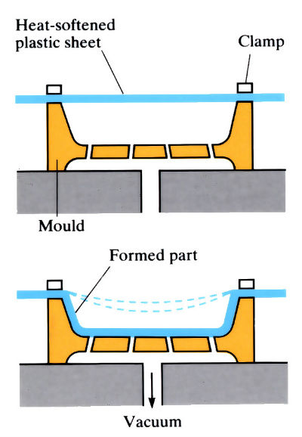
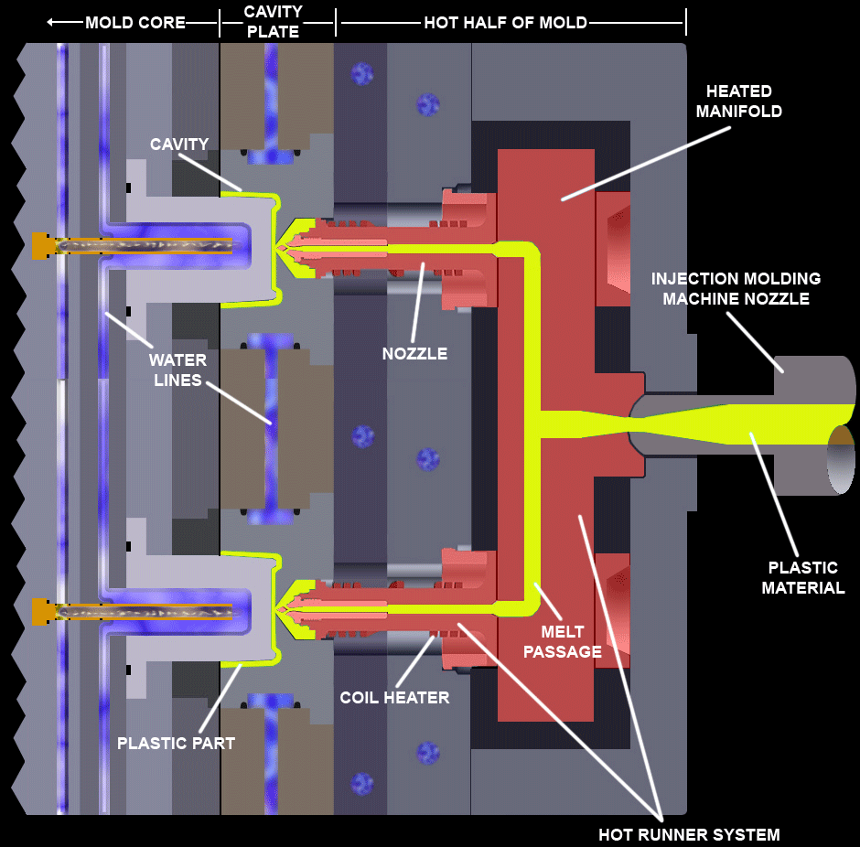
Manufacturing
1961 Hot Runner mold
Early 1970s thermoforming
1965 vacuum molding

Slide 8
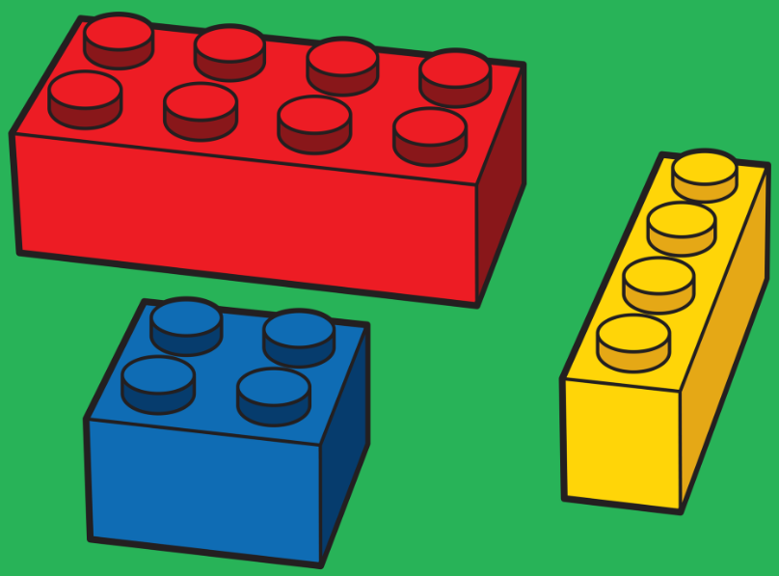
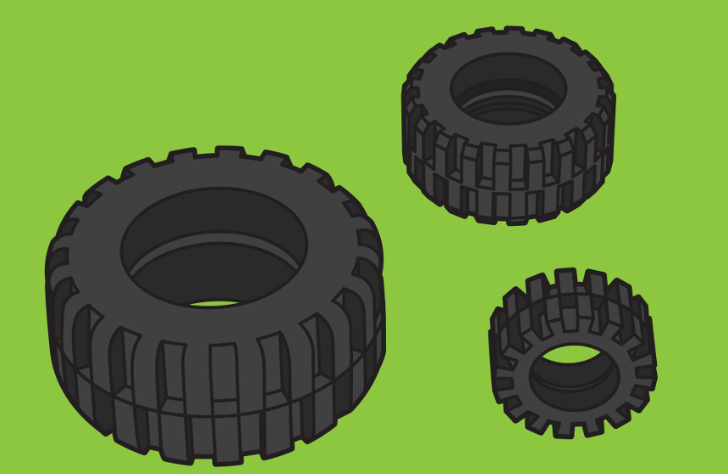
ABS (Acrylonitrile Butadiene Styrene)
Hard plastic
Scratch resistant
Easily moldable
HIPS (High Impact Polystyrene)
Strong
Tough
SEBS (Styrene-Ethylene-Butylene-Styrene)
Soft
Elastic
Behaves similar to rubber
LEGO makes the most tires per year!

Slide 9
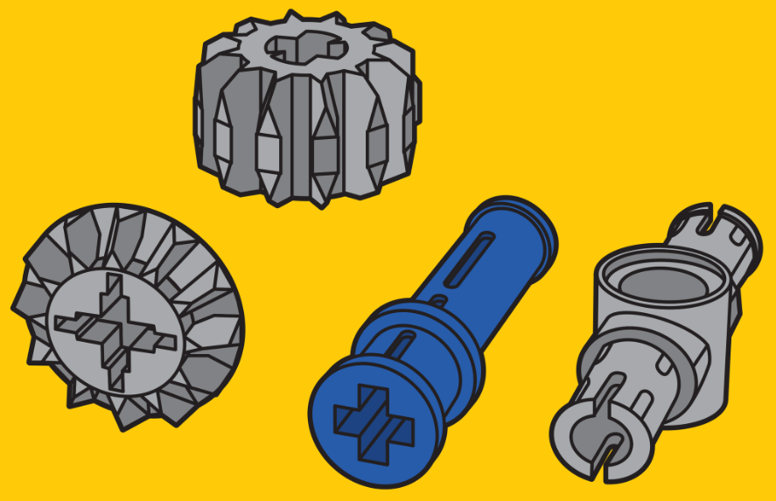
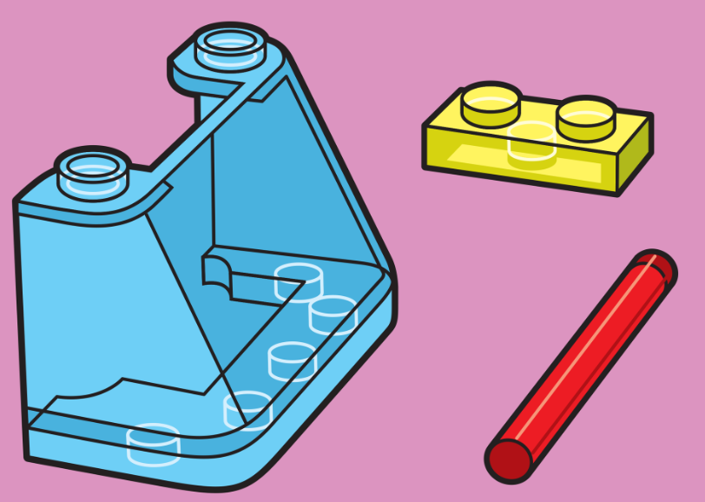
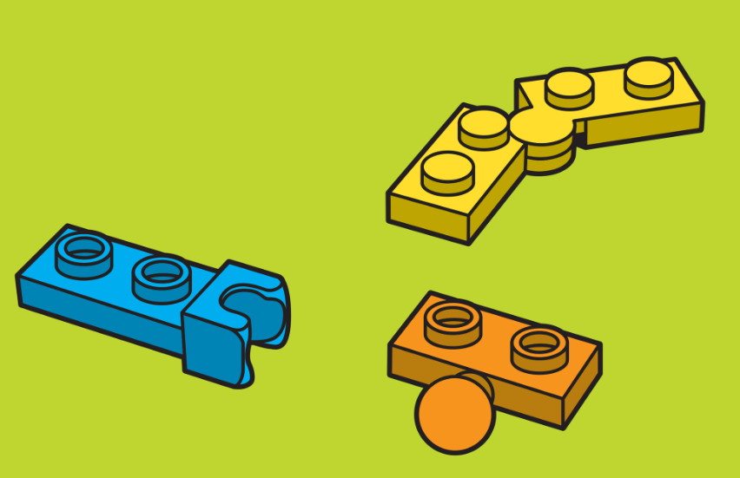
PA (Polyamide)
Absorbs high loads and impacts
MABS (Methyl Methacrylate-Acrylonitrile-Butadiene-Styrene)
Transparent
Not as strong as ABS
PC (Polycarbonate)
Strong
Impact resistant

Slide 10
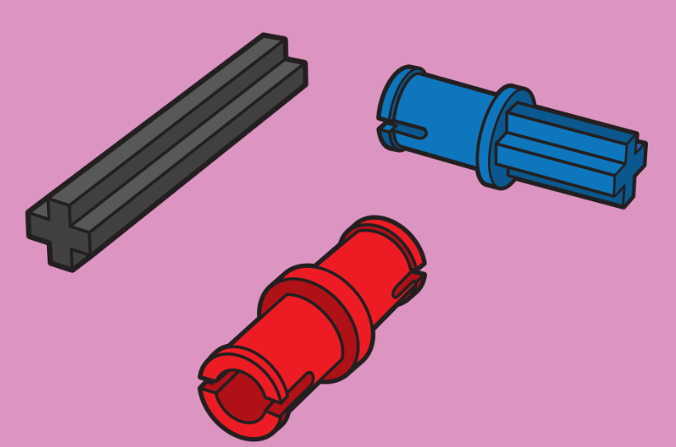
POM (Polyoxymethylene)
Stiff
Flexible
Strong
Dimensional stability
PE (polyethylene)
Soft
Durable
Flexible
Made from sugarcane!!

Slide 11
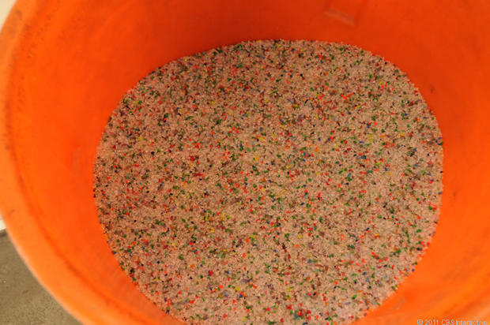
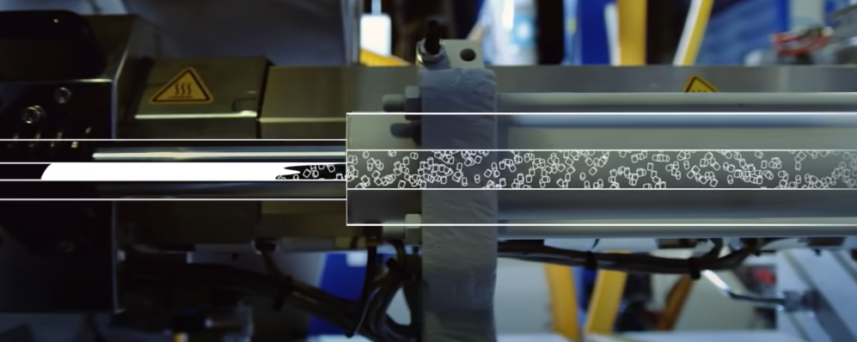
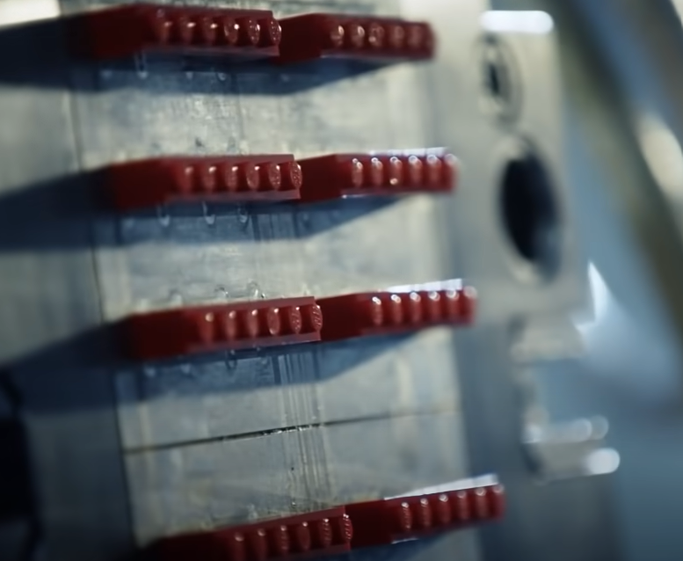
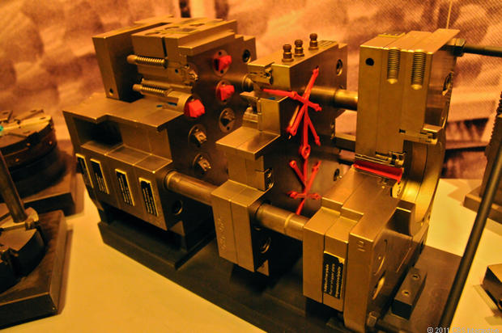
Manufacturing Process Today
Plastic Granulate
Heated to about 230°C
Forced into the mold at up to 29 ksi
Notes:
3:08-3:18

Slide 13
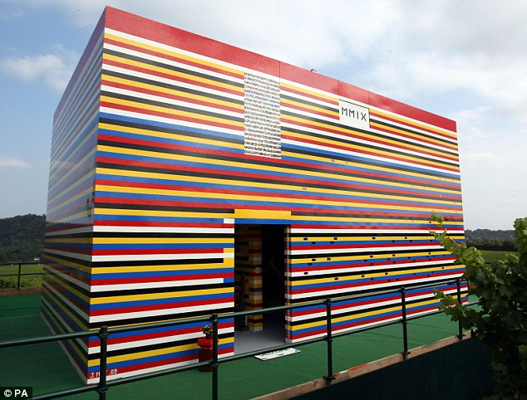
LEGO House
3.5 million bricks!!
3800 hollow blocks
272 bricks each
12 x 6 x 8 bricks

Slide 14
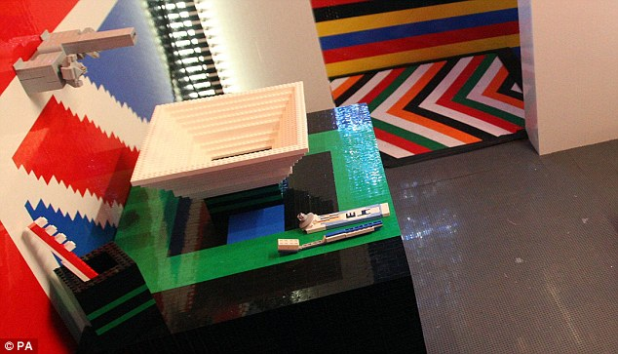
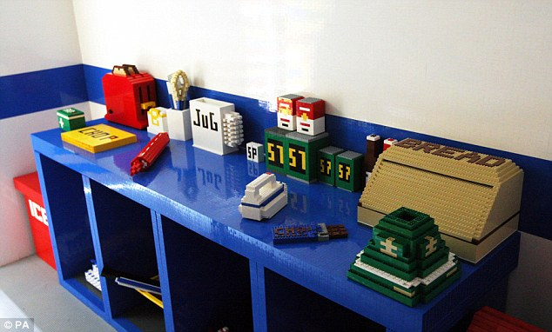
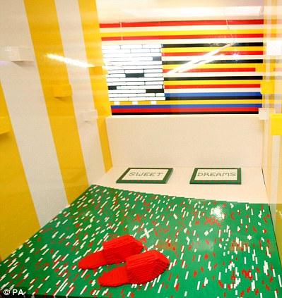
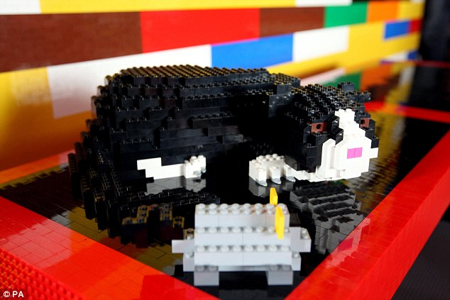
Inside the LEGO House

Slide 15
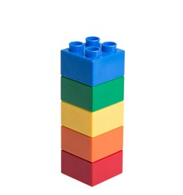
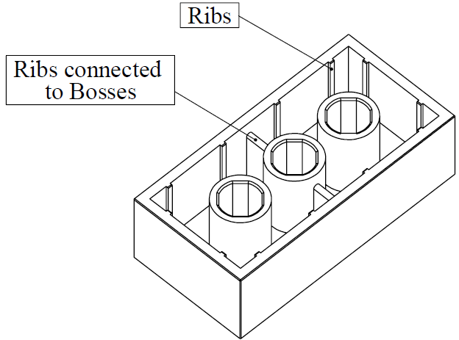
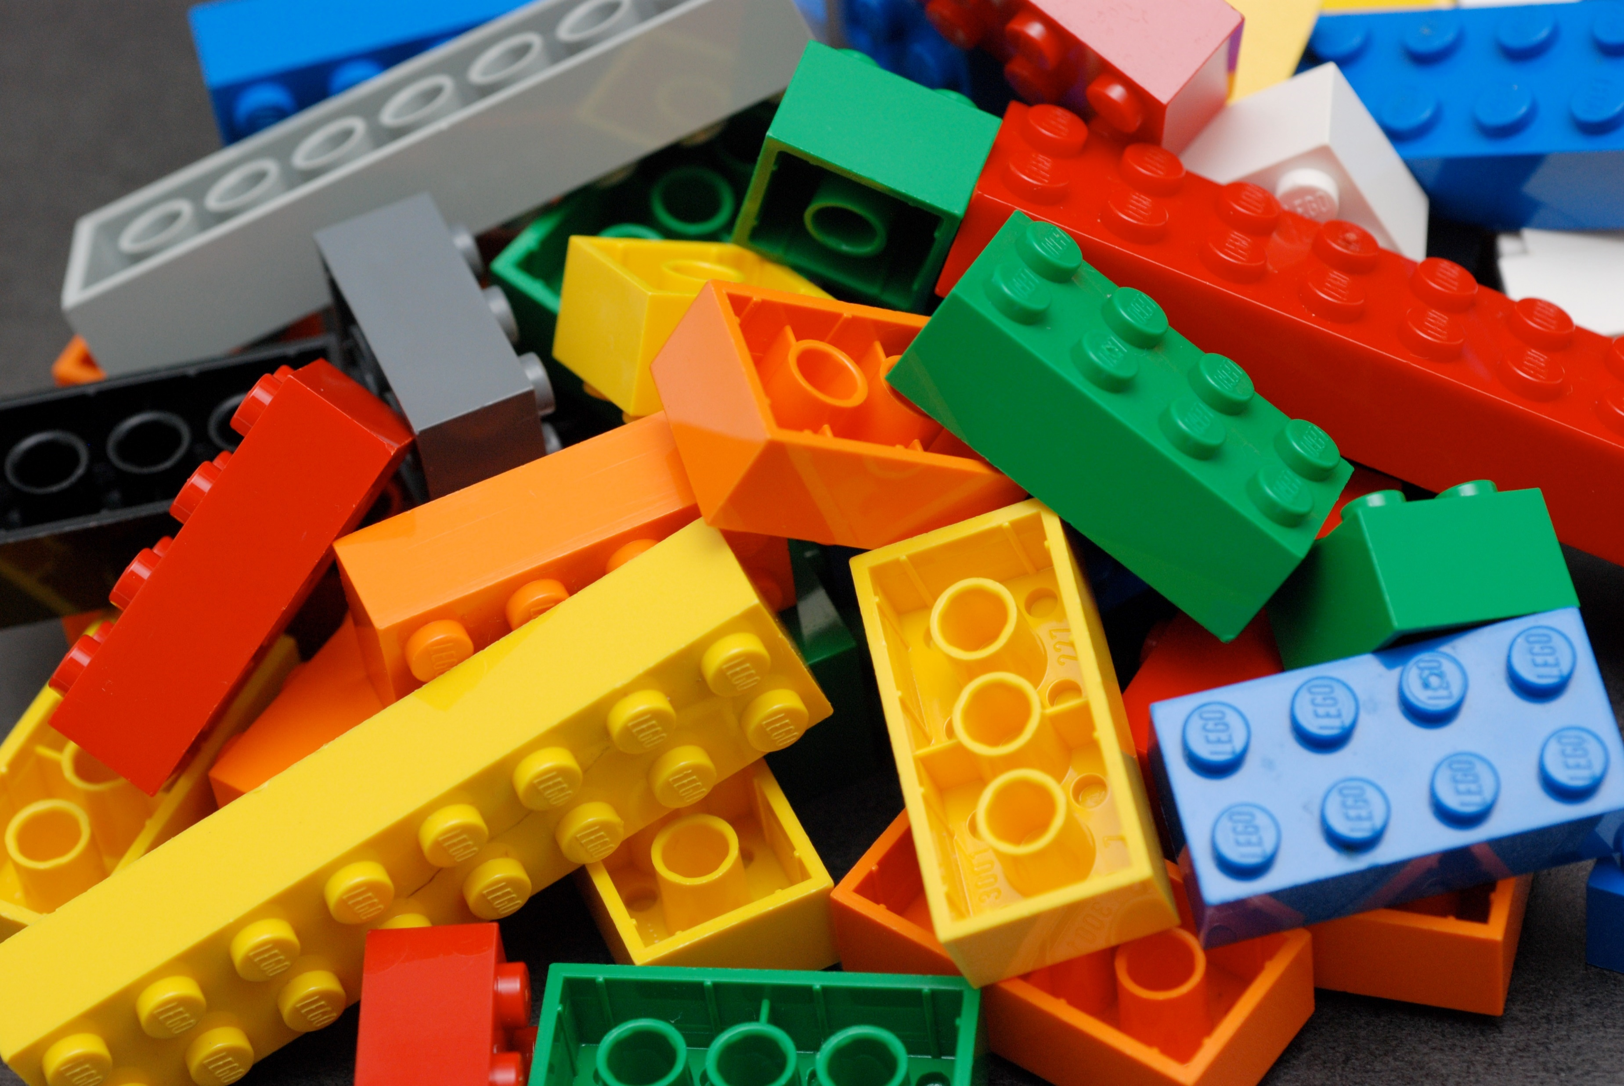
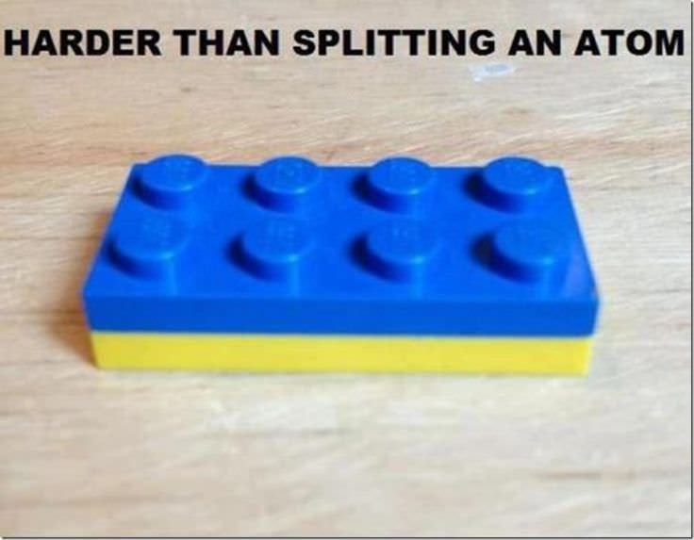
Why Can’t We Realistically Build a House Out of LEGO Bricks?
Held together with a snap fit
Friction dependent
Under tension, they want to separate
But, good in compression
2x2 brick withstood 4240N
Equivalent of 375,000 bricks stacked on it
2 mile high tower
Good in shear also

Slide 16
Why Can’t We Realistically Build a House Out of LEGO Bricks?
Not really cost effective
A masonry brick costs $0.65
The LEGO House cost roughly $350,000 in just LEGO bricks
$$Cost of 1 LEGO equivalent masonry brick=\frac{272 LEGOs}{1 masonry brick}×\frac{\$0.10}{1 LEGO}=\$27.20$$

