Slide 1
academic family tree
Dogbone Presentation
Catherine Barrie
September 25, 2023

Slide 2
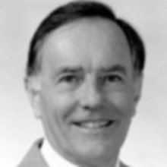
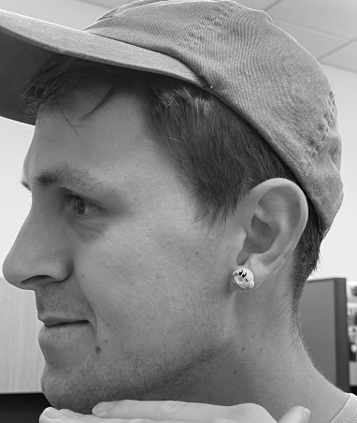
Direct Line
Kevin J.
Hemker
William D.
Nix
Robert A.
Huggins
John
Wulff
Walther
Gerlach
Friedrich
Paschen
Johns Hopkins
University
Stanford
University
Stanford
University
Universität München
Universität Tübingen
MIT
August
Kundt
Heinrich Gustav
Magnus
Eilhard
Mitscherlich
Universität Berlin
Universität Berlin
Universität Berlin
Notes:
Nix – Research focused on mechanical properties from high temperature creep, deformation mechanisms, thin films, nanomaterials mentoring names such as Prof. Hemker, Tim Weihs, George Pharr, Julia Greer, Michael Uchic, Jeffery Gibeling, Joost Vlassak
Huggins – Established the materials science department at Stanford where he worked on mechanical behavior of materials, crystal growth, solid state diffusion. He was one of the founders of the Materials Research Society in 1973. Was still publishing as of 2016. Son of Flory-Huggins which describes thermodynamics of mixing for polymer solutions. HES STILL ALIVE AT 94.
John Wulff – Pretty limited information on him but it appears that he was beloved as a teacher at MIT (and taught intro to solid state chemistry) and his research focused on solid state diffusion of metals (lots of sintering studies, surface tension of solid metals, etc). He published a book on the structure of materials in 1964.
Walther Gerlach – Received his degree in 1912 under Paschen. In 1922 he was one of the scientists who discovered spin quantization in magnetic fields (Stern—Gerlach experiment). In 1925 -1929 he spent time as a professor at the Universitat Tubingen when he mentored John Wulff. He then worked for the universitat munchen (Munich) from 1929-1937. From 1937-1945 he was on the advisory board for the Kaiser Wilhem Gesellschaft (KWG) in Germany. He was arrested by the Americans in 1945 because of the KWG’s hand in human experiments with the Nazi’s. The KWG was then absorbed by the Max Planck institute and in 1946 Gerlach was allowed to return to Germany to continue science work.
Friedrich Paschen – Louis Carl Heinrich Friedrich Paschen was known for his work now known as the Paschen series. The Paschen curve plots breakdown voltage as a function of pressure for gases. This describes the voltage and pressure relationship needed to cause an arc between two plates.
August Kundt – Most notable accomplishments include his work in anomalous dispersion (when refractive index increases with with increasing wavelength (opposite of normal dispersion)) and the invension of Kundt’s tube where a fine powder suspended in an air wave in a tube will have regions of high and low concentration.
Heinrich (Gustav) Magnus – An experimentalist who for much of his career was a chemist, however the later part of which he branched into physics where he studied what is now known as the Magnus effect which describes how a spinning projectile moves through a fluid.
Eilhard Mitscherlich – Originally went to school in 1811 for philology (the study of oral history) with a concentration in Persian. He wanted to go work in the Persian embassy that Napoleon was setting up, however Napoleon’s retirement ended this dream. Instead, he decided to study medicine so he could travel to Persia. However, when he started his chemistry classes he was so enamored he decided to become a chemist. He then worked in identifying compositions of various phosphates and other chemicals, before he began theorizing on crystallography. He discovered allotropy AND polymorphism!

Slide 3
Notable Names
John
Wulff
MIT

Slide 4
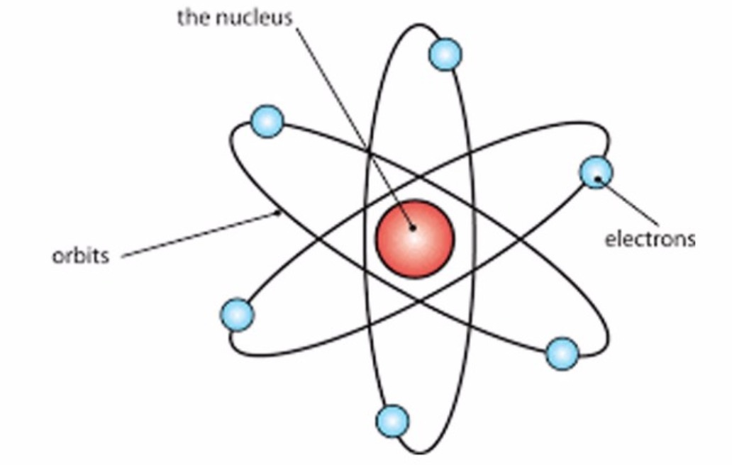
Notable Names
Noble Prize winner
Discovered half-lives
Rutherford model of the atom
Ernest
Rutherford
Cambridge
Hans
Geiger
Universität
Berlin
Set up experiments leading to discovery of the atomic nucleus
Aided many Nobel prize winners
Experiments of radioactive particles (Geiger counter)
John
Wulff
MIT
Notes:
John Wulff has a post-doc with Hans Geiger
Hans Geiger is well known for his experimentation which led to the discovery of the atom and helped many Nobel prize winners.
One of these Nobel prize winners was especially well known for the experiments that Geiger did when he worked as a research scientist. Ernest Rutherford – well known for the Rutherford model of the atom – also made significant contributions to research on radioactive materials.
If you remember from your high school chemistry classes, the Rutherford model of the atom was well known for disproving another theory.

Slide 5
Notable Names
Mathematician who studied mechanics
Edward
Routh
Cambridge
John William
Strutt
Cambridge
Lord Rayleigh the 3rd
Rayleigh scattering
Wave and fluid dynamics
Joseph John
Thomson
Cambridge
Noble Prize winner
Discovered electrons!
Isotopes exist
Ernest
Rutherford
Cambridge
Notes:
That theory was JJ Thomson’s plum pudding model, who also happened to be Rutherford’s advisor. Although his end model was wrong, Thompson also made huge contributions to the science world, he was a Nobel prize winner himself, who showed that electrons and isotopes existed. Note that is discovery of isotopes came AFTER (1913) the discovery of the nucleus (1911). His theory needed to be disproven for this other discovery!
JJ Thomson went to college at 14!! And he studied under two well known scientists. John William Strutt, better known as Lord Rayleigh, is most well known for his theories about elastic scattering of light by particles much smaller than their wavelength. He had many other contributions in the fields of wave and fluid dynamics
The second of which was Edward Routh

Slide 6
Honorary Mentions
Grad Student
Legend
Post-Doc
Research Scientist
8 steps
8 steps
9 steps
9 steps
9 steps
12 steps
Gustav Robert
Kirchhoff
James Clerk
Maxwell
Charles
Darwin
Robert
Bunsen
Justus von
Liebig
Antoine
Lavoisier
Universität Berlin
Cambridge
“Independent”
Universität Heidelberg
Universität München
University of Paris
Schuster
Schuster
Huxley
Frankland
Frankland
Berthollet
Rutherford
Rutherford
Bickerton
Bickerton
Bickerton
Gay-Lussac
Rutherford
Rutherford
Rutherford
Von Liebig
Notes:
Gustav Kirchhoff – best known for Kirchhoff’s Law (current flowing into a node must be equal to the sum of the currents leaving, sum of voltages around a closed loop must be zero). He was the advisor of Arthur Schuster (who’s accomplishments include coining the term “antimatter” and the periodogram analysis which helps to establish statistically important frequencies) who later worked and mentored Rutherford.
James Clerk Maxwell – Who is well known amongst material scientists for the creation of Maxwell relations (relationships between thermodynamic variables), the Maxwell-Boltzmann distribution describing statistical thermodynamics, the idea that electrical and magnetic fields travel as waves at the speed of light.
Charles Darwin – I don’t think much needs to be said about him
Robert Bunsen – aka the inventor of the Bunsen burner! He also helped discover the best antidote for arsenic poisoning (accidentally). He should be a lesson in lab safety as he himself got arsenic poisoning (and nearly died!) and blinded himself in his right eye from working on cacodyl (an arsenic based toxic oily liquid) which spontaneously combusts in air. He also used electrolysis to produced pure metals (Cr, Mg, Al, Mn, Na, Ba, Ca, Li). It was actually his work with Kirchhoff which led the to invention of the Bunsen burner. His connections to Rutherford are Edward Frankland, who was involved with the discovery of Helium, and Alexander William Bickerton, who is most well known for mentoring Rutherford…
Justus von Liebig – He mostly just has a really cool name. He is considered one of the founders of organic chemistry whos worked contributed to agricultural and biological communities. He did extensive research of nitrogen and how plant growth was dependent on the availability of the scarcest nutrient. He also created a company which made beef bouillon cubes.
Von Liebig after studying with a guy by the name of Kastner, left (maybe because of a scandal) to work for Joseph Louis Gay-Lussac who is well known for his work on gases. Through Claude Louis Berthollet (who worked on reverse chemical reactions and founded current chemical nomenclature), is Antoine- Laurent de Lavoisier. He discovered that oxygen plays a significant role in the combustion process, helped make the metric system, helped form the first list of elements which then led him to predict the existence of silicon! He was also the first to pitch the conservation of mass idea. His wife, Marie-Anne Lavoisier was his lab assistance and was instrumental in the standardization of the scientific method! They married when Antoine was 28 and Marrie-Anne was 13… BUT he did this to save her from having to marry a 50 year old and he let her work in his lab… He was involved in some sketchy activities which he supposedly did to fund his research. He committed tax fraud and was an underground tobacco dealer so he was guillotined during the French Revolution.

Slide 7
GUESS THAT COMMON ANCESTOR
?
Professor
Doe
University Unknown

Slide 8
Common Ancestors
?
?
?
?
?
Professor
Doe
Professor
Doe
Justus von
Liebig
Robert
Bunsen
Ernest
Rutherford
August
Kundt
Professor
Doe
Ernest
Rutherford
Professor
Doe
Professor
Doe
University Unknown
University Unknown
Universität Berlin
University Unknown
Universität Heidelberg
University Unknown
University Unknown
Universität München
Cambridge
Cambridge
Erwin
Schrödiner
Jane
Goodall
Tresa
Pollock
Jaafar
El-Awady
J. Robert
Oppenheimer
UC Santa Barbara
Johns Hopkins University
Universität Wien
Cambridge
UC Berkeley

Slide 9
Other Relations
Johann Bernoulli (math guy)
Michael Faraday
Franz Neumann (Neumann’s Law)
Hermann von Helmholtz (Helmholtz Free Energy)
James David Forbes (brother to THAT Forbes)
William Thomas (Lord Kelvin)
Friedrich Stromeyer (discovered cadmium)
Humphry Davy (discovered like half the periodic table)
Joseph Louis Proust (law of definite proportions)

