Slide 1
Diamonds: Their uses; the lab-created debacle; and why, as a woman, am I supposed to be obsessed with them?
Kate Brizzolara
Dogbone Presentation, Spring 2023

Slide 2
Agenda
What is a Diamond?
Carbon Allotropes
History of Diamonds
Origins
Why do we give Diamond Engagement Rings?
Natural vs. Lab-Grown: Are they fake?
The 4C’s (warning: if you’re single this may stress you out)

Slide 3
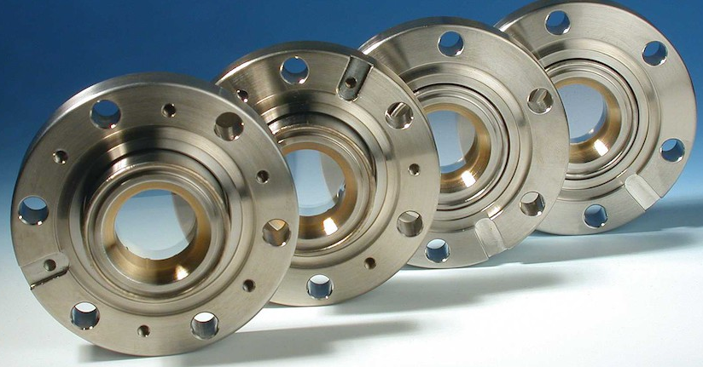
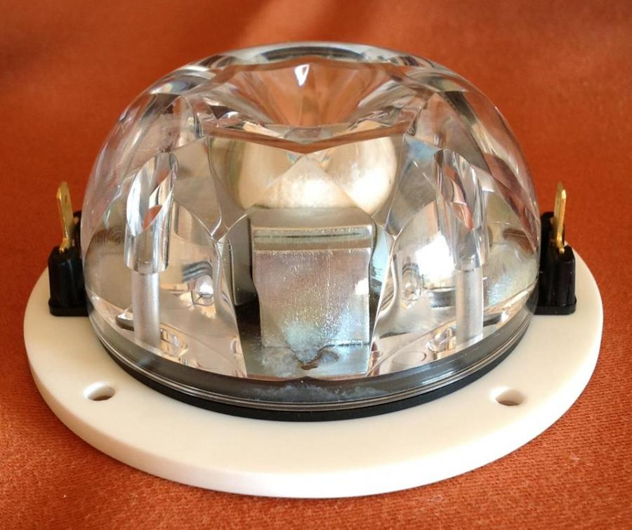
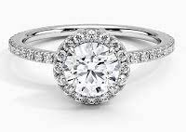
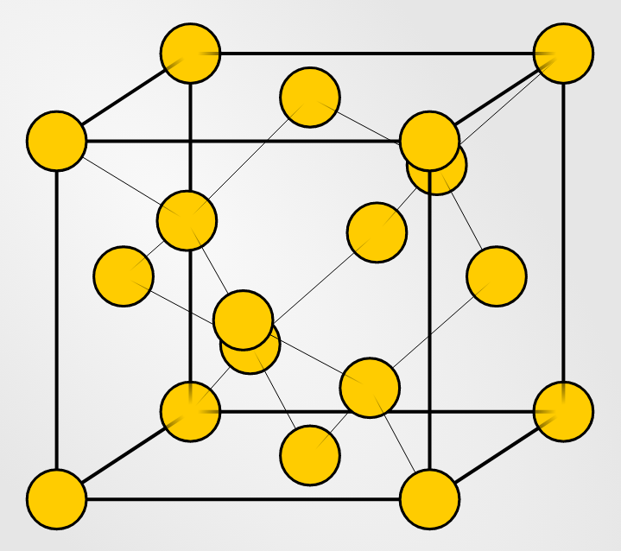
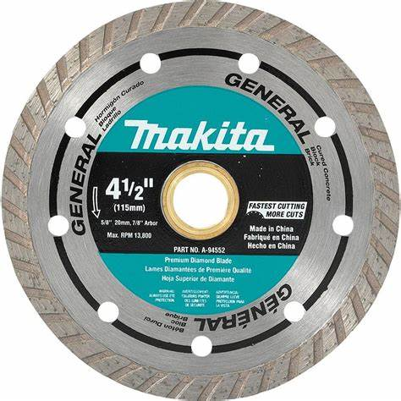
What is a Diamond?
Entirely made of carbon in a “diamond cubic” crystal structure
Variety of colors due to impurities, inclusions, radiation exposure
Hardest natural material – 10 on Mohs scale
Tensile strength is UNKNOWN
3.5 g/cm³ density
Highest thermal conductivity, sound velocity
High electrical resistance and optical dispersion
Low adhesion, friction, and coefficient of thermal expansion
Highest terrestrial molar volume material
Uses: Cutting/polishing, jewelry, diamond windows, diamond speaker domes, heat sinks for microelectronics
Notes:
Diamond window – thin diamond membranes. Used to cover openings in lasers, x-ray machines and vacuum chambers.
Diamond speaker domes – diamond is stiff so it can vibrate rapidly without deformation (which would degrade sound quality). $6281.00
Heat sinks – diamonds have high thermal conductivity (the highest of all natural materials). Used to conduct heat away from heat-sensitive microelectronics. Made via CVD.
Molar volume = most atoms packed into a volume

Slide 4
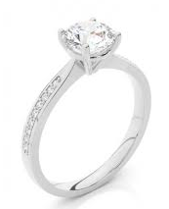
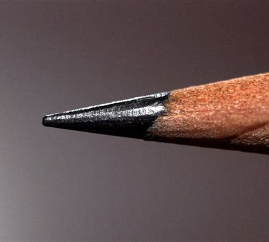
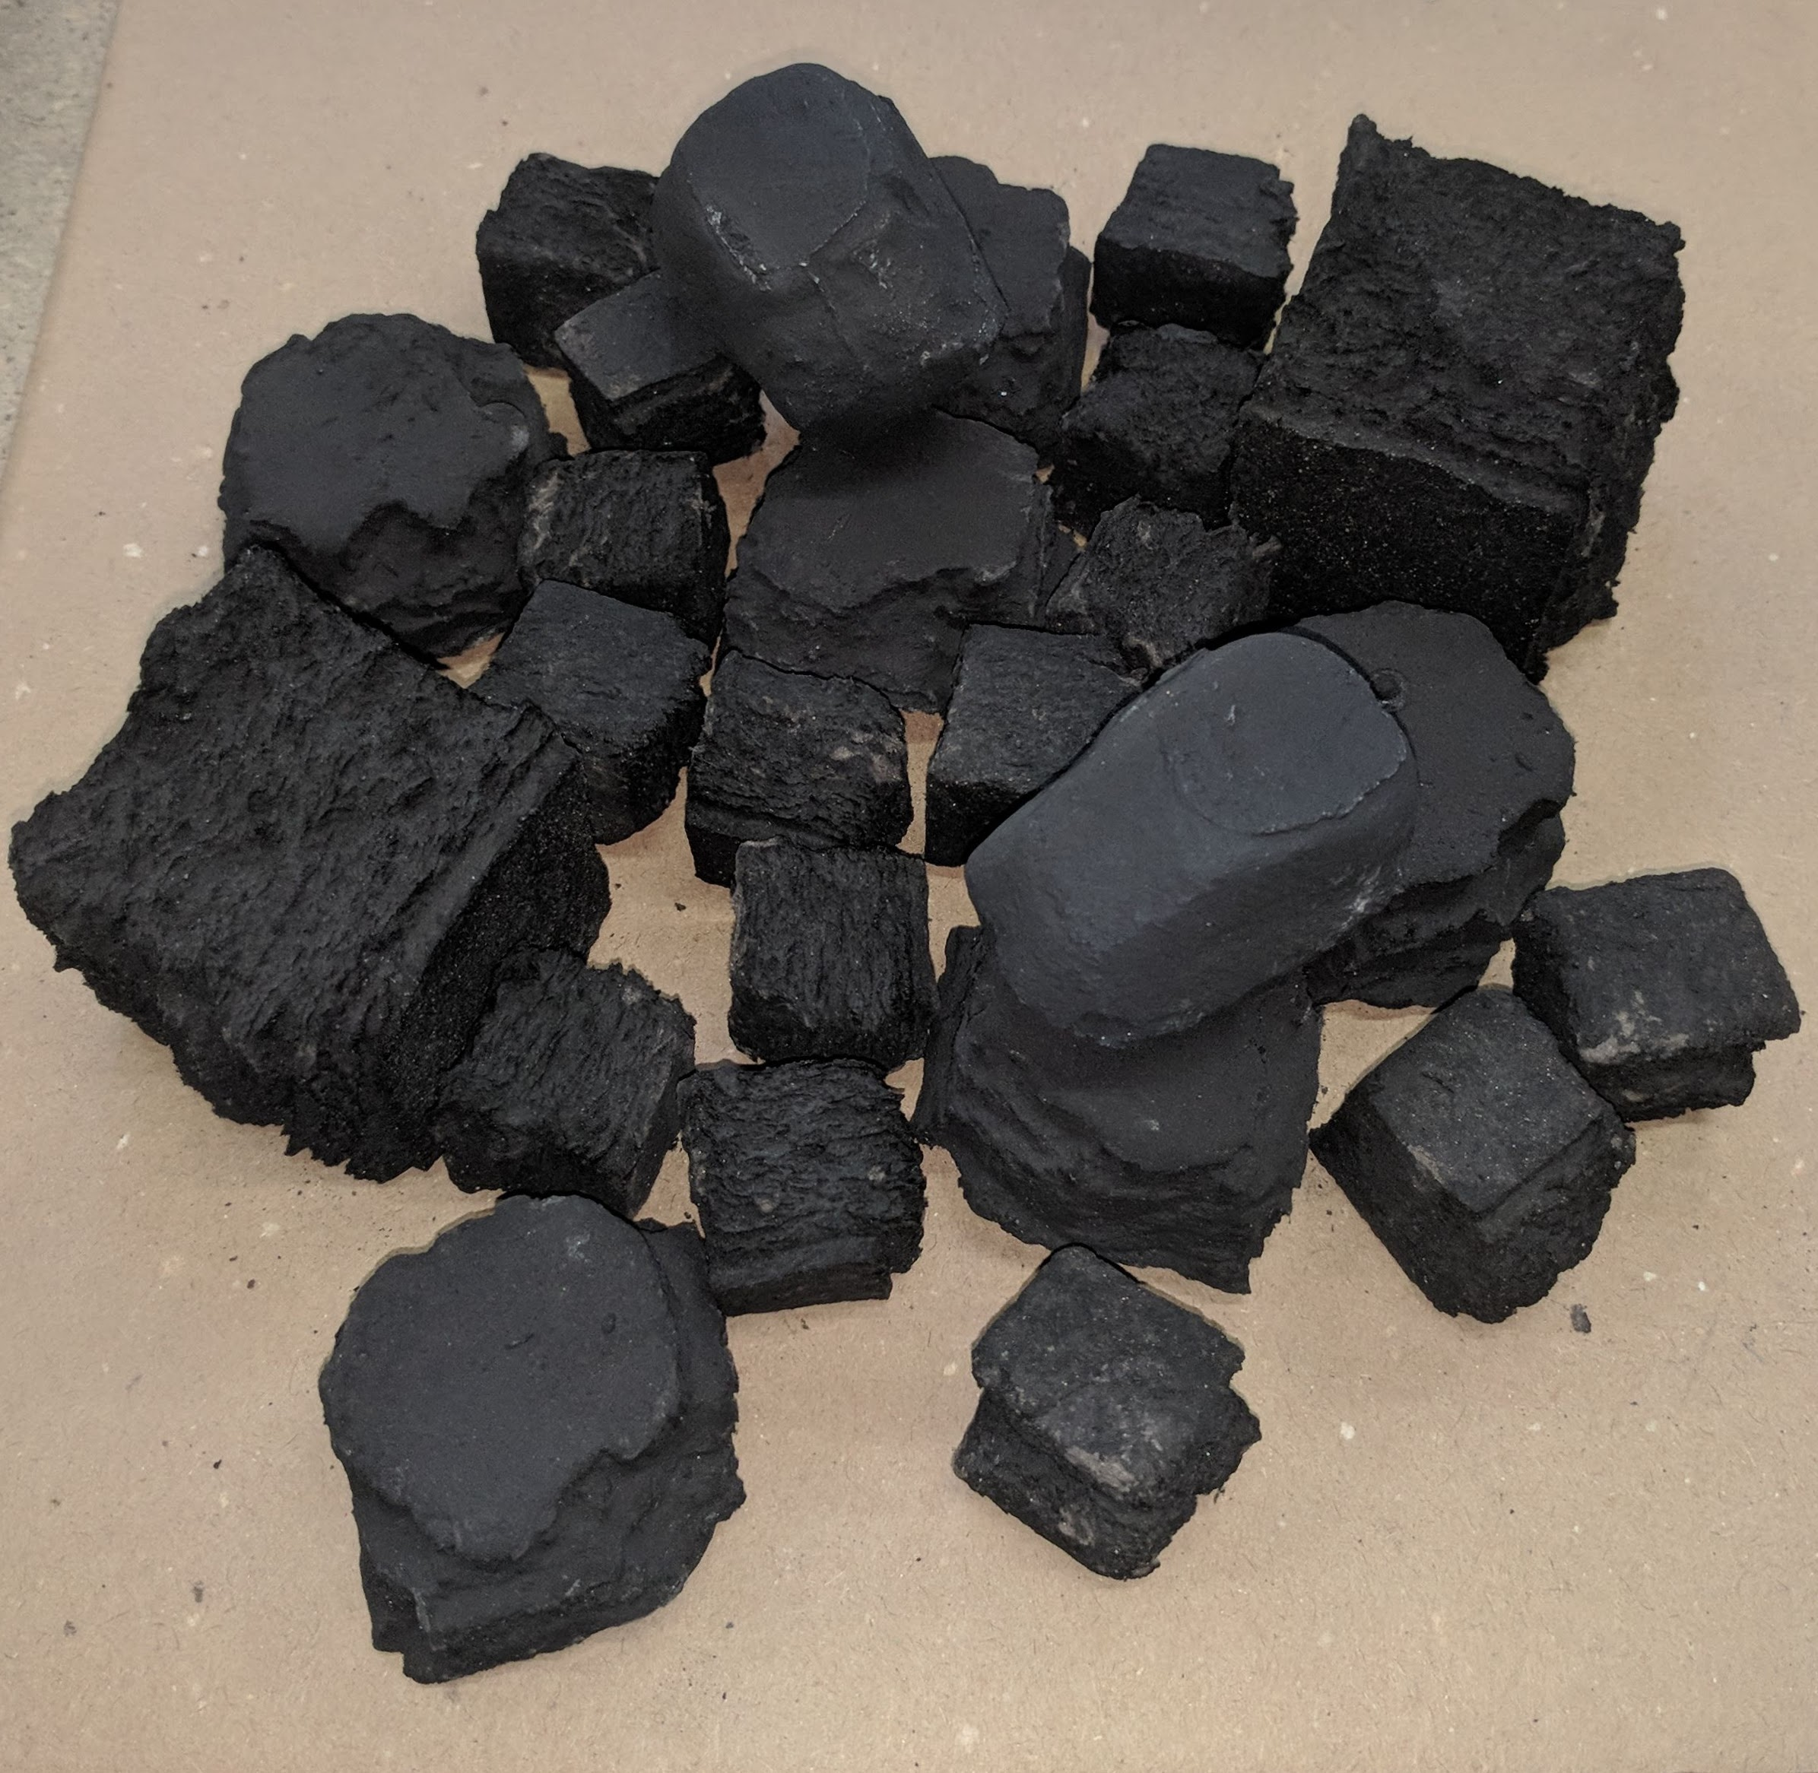
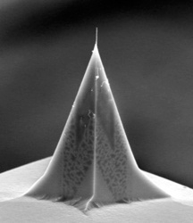
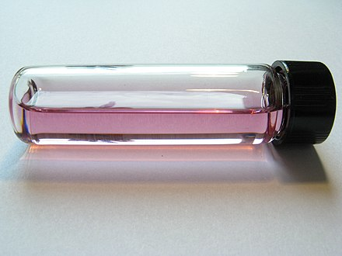
Comparison of Carbon Allotropes
$40,000-$400,000/g
$150 million/g
$0.000016-$0.00012/g
$2/g
$0.30/g
Graphite
Fullerene (Bucky Ball)
Amorphous Carbon
Carbon nanotubes
Diamond
Fun Facts:
Diamond tetrahedra is strong, structurally
Diamonds have most # of atoms per unit volume of all substances – makes it hard.
Bonds between nearest neighbors (in hexagonal plane) in graphite are stronger than individual bonds in diamond. Makes diamonds MORE flammable than graphite.
$100/g
Graphene
Notes:
ASK IF THEY KNOW EACH OF THE STRUCTURES BEFORE REVEALING THE NAME
Less strong BONDS not structure makes diamond more reactive with O2 and therefore more flammable
Each of these could be their own dog bone.
Diamonds – cost is dependent on 4c’s, a 1 gram diamond is equivalent to 5 carats: $40,000-$400,000/g. Use is diamond rings + other mentions
Graphite – furnace linings, anodes in batteries, pencils. $0.30/gram
Fullerene (C60, Bucky Balls) – tumor research, C60 can absorb HeLa cells and react to radiation which is theorized to protect surrounding healthy tissue. World’s most expensive material $150 million/g. Bucky balls could be their own dogbone and so could HeLa cells.
Amorphous Carbon – literally coal. $0.000016-$0.00012/g (dependent on exact type of coal). Coal could be it’s own dogbone.
Carbon Nanotubes – bike parts, atomic force microscope probe tips, adhesive tapes, vantablack, bone growth scaffolding. Could be it’s own dogbone. $1500/g in 2000, $50/g in 2010, $2/g (2016)
Graphene – Potential uses in solar cells, LED’s, touchscreens, tennis racquets. $100/g

Slide 5
Why do we give Diamond Rings?
Before 1940, Diamonds were just one option for engagement rings
After the 1930 economic downturn, in 1947, DeBeers company coined the slogan “Diamonds are Forever” and created the 4C’s as marketing tactics
Meant to show of “earning power” of the man and “worth” of the woman (GIA’s words, not mine)
1953 – Marilyn Monroe “Diamonds are a Girl’s Bestfriend”
Diamonds have high resale value, making them desirable for a potentially ~risky~ activity
% of Brides receiving diamond engagement rings: 10% in 1939, 80% in 1990

Slide 6
Natural vs Lab-Grown

Slide 7
Natural Diamonds
Takes a few million to billions of years to crystallize within the Earth’s mantle.
Diamonds are dated using elements in inclusions of minerals within them. It is believed most diamonds were formed when the earth was newly formed itself, and much hotter.
Diamonds that we mine today are brought to the crust by violent volcanic eruption that happened thousands of years ago (when the earth was hotter, magma came from deeper in the mantle)
Source of carbon is still unknown and debated among scientists (plant, animal, sediment material carried into the mantle during tectonic movement)
Formed at depths of 93-155 miles

Slide 8
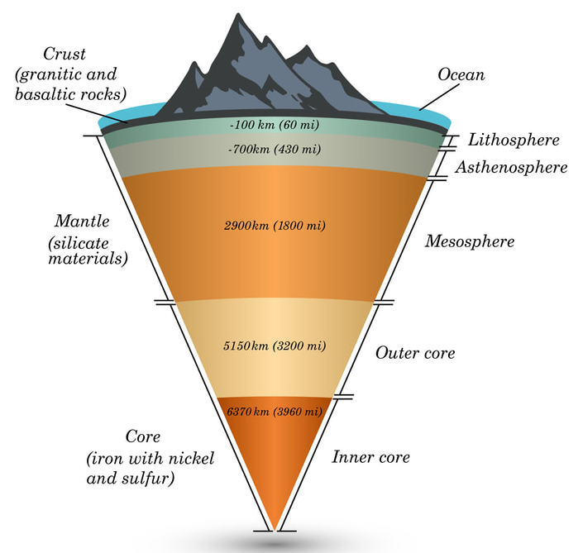
93 miles
155 miles
500 miles

Slide 9
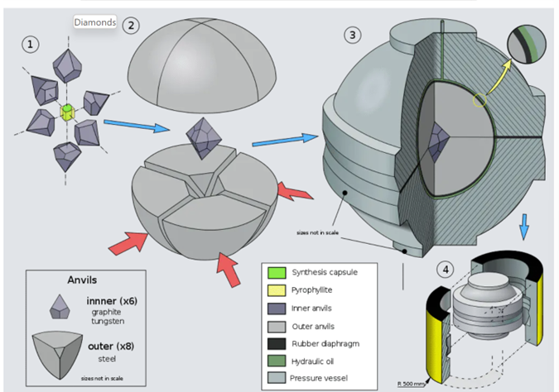
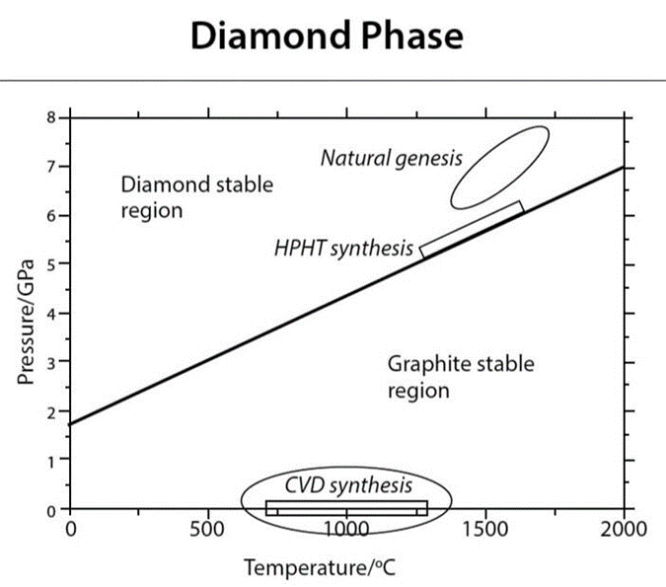
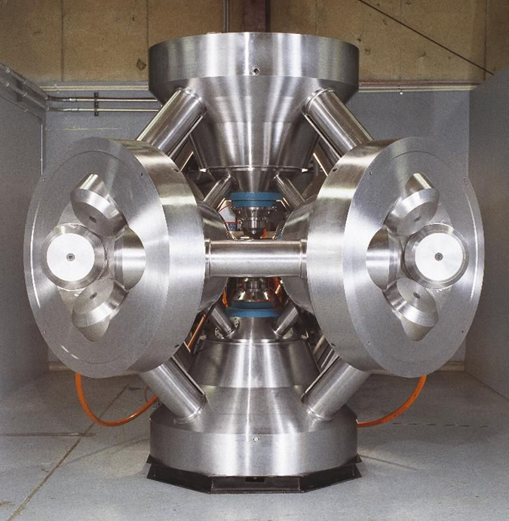
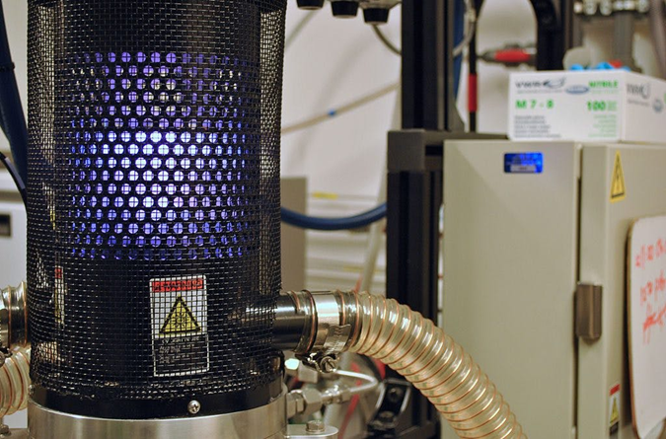
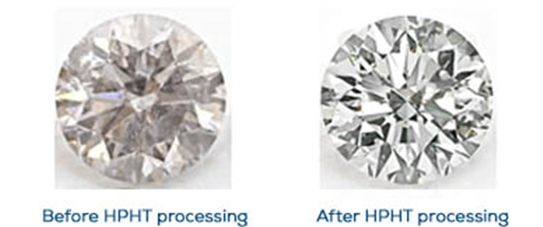
Synthetic Lab-Grown Diamonds
Two methods of growth:
High Pressure High Temperature (HPHT) Process
Chemical Vapor Deposition (CVD)
Electrical conductivity can differ due to boron inclusions in lab grown diamonds, making it less insulative.
They also tend to be slightly magnetic due to metallic inclusions
Lab grown will fluorescence after excitation by low wave UV light (sunlight even!)
Notes:
HPHT:
Developed in the 1950’s by GE. Started in the 1940’s but got interrupted by WW2
Starting materials include graphite, metal flux (mix of metals – iron, nickel and cobalt), small diamond seed placed into a capsule which is placed into an oil bath (to help with heat transfer)
Heated to 1300C-1600C and pressed to 59200 atm (with cells with special geometries)
Metal flux reduces the temperature target needed
Graphite mixes with the molten metal flux and crystallizes around the diamond seed
Takes hours to weeks dependent on carat and quality desired
Presses: belt (two anvils), cubic (6 anvils), split-sphere (8 outer anvils, 6 smaller inner anvils)
Diamonds undergo additional heat treatments to improve/change color, clarity
Can also be used to improve natural or cvd diamonds (enhancement to color and clarity)
CVD:
Chamber is filled with carbon, hydrogen and oxygen gases
Thin sliver substrate of diamond seed or graphite
Heated via microwave, lasers or hot filament to 800-900 C
Energy from heat causes precipitation of carbon out of gaseous mixtures and it sticks to the substrate which then crystalizes (forming diamond)
Process must be paused often to remove graphitic buildup
Takes days to weeks, but can grown multiple at once
Most diamonds come out yellow or brown. Additional heat treatments needed to make them colorless
Easier to control and monitor, lower pressures and smaller machines. More common.

Slide 10
Grading Diamonds/4C’s (a buying guide, if you will …. you’re welcome)
CUT
CLARITY
CARAT
COLOR
Notes:
Developed by DeBeer’s in the 1940’s as a marketing tactic to make ring shopping easier for couples

Slide 11
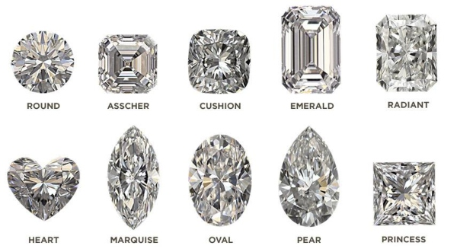
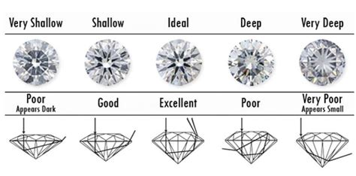
Cut
How well a diamond’s facets interact with light
Types of Cuts: Brillance and Step
Brillance cuts – triangular and kite shaped facets to maximize sparkle. Round, princess and oval shapes.
Step cuts – facets on all four sides, flat surface on top. Facets look like steps into diamond, mirror like appearance. Emerald, Asscher shapes.
Grades of Cuts: Excellent, Very Good, Good, Poor
Excellent - reflects almost all light going into the gem (top 3%)
Good – Diminishing appearance because of lack of reflection (top 25%)
Cut makes or breaks the diamond’s appearance. Considered the “most important C”.

Slide 12
Clarity
Absence of inclusions and blemishes.
Flawless (FL) – No inclusions and no blemishes visible under 10x mag
Internally Flawless (IF) – no inclusions visible under 10x mag
Very, Very Slightly Included VVS₁ and VVS₂) – Inclusions so slight they are difficult for skilled grader to see under 10x mag
Very Slightly Included (VS₁ and VS₂) – Inclusions are observed with effort under 10x mag, but can be characterized as minor
Slightly Included (SI₁ and SI₂) – Inclusions are noticeable under 10x mag
Included (I₁, I₂, and I₃) – Inclusions are obvious under 10x mag which may affect transparency and brilliance

Slide 13
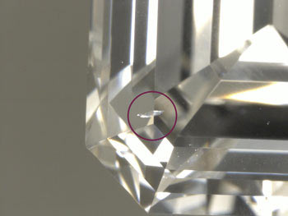
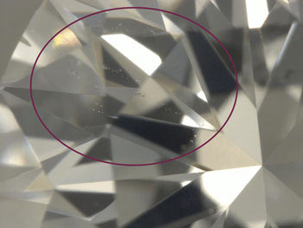
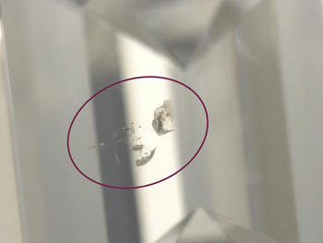
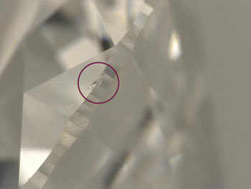
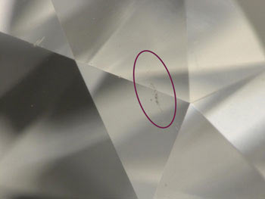
Clarity - Types of Inclusions
Cavity – Surface dents, cracks. Affects reflectivity. Can be colored because of mineral deposits.
Cloud – small pinpoints (“blackheads of diamonds”) clustered together. Dull, hazy look.
Mineral Inclusions – Included minerals include garnet, diopside, spinel, calcite, silica etc. Can lower clarity.
Feathers – Small cracks, appearing feathered. Can have no affect or can make the diamond appear white.
Graining – Due to irregular crystal growth. White, colored and/or reflective internal lines. Hazy look.
Can have a lower grade clarity and still appear “eye-clear”! Depends on cut, size of inclusions and setting.

Slide 14
Carat
Measure of a diamond’s apparent size (by weight).
1 carat = 0.2 grams
1 carat is assigned 100 points, making carat weight precise and down to the hundredth of decimal place
Carat size is dependent on cut. Some cuts have geometries that make them appear larger. As do some settings.

Slide 15
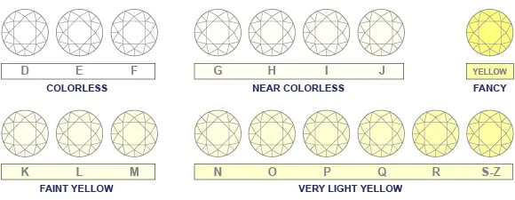
Color
Refers to a diamonds LACK of color
Color is due to impurities of nitrogen
Z Diamonds are not “Fancy-color” diamonds. These are diamonds that exhibit a slight “muddy” color that’s different than a “fancy” yellow diamond.
When slight amounts of color are present, less natural white light (all the colors) will be reflected back out of the diamond – leading to a less “sparkly” appearance.
Near colorless diamonds requires a microscope to pick up on coloration differences
Dependent on setting (i.e. gold or rose gold), more impurities of nitrogen are less noticeable.
Some I,J or K diamonds are heat treated via HPHT to create “fluorescence” which creates a blue tint.
G,H,I are considered the sweet spot for # of impurities and coloration changes that are undetected by the human eye.
Notes:
D-I are generally ok once cut and in their settings

Slide 16
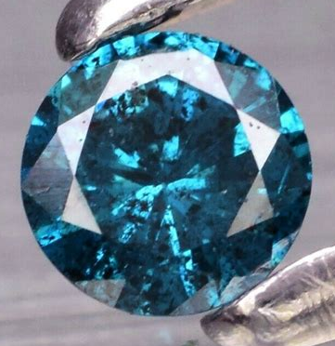
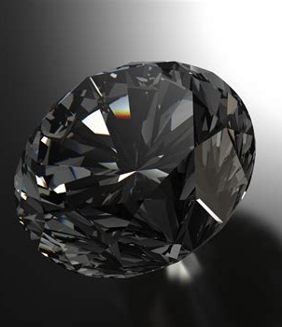
Color - “Fancy” Diamonds
Diamond color can be affected by defects or a few atoms of impurities – when major color changes occur, the diamonds are referred to as “Fancy Diamonds”
Boron
Nitrogen
Defects
Nickel
Radiation
Notes:
These also affect their properties. Boron turns an electrical insulator to an electrical conductor (and in some cases a superconductor) → can use these diamonds in electronic applications
Nitrogen impurities hinder dislocations movement in the lattice and put it under compressive stress. Thereby increasing toughness and hardness.

Slide 17
Pro Vs. Con Lab-Grown
PRO:
Definitely not a blood diamond
More bang for your buck (aka more carats for lower cost)
More control over clarity, color
Potentially not supporting Russian diamond mines
CON:
Hasn’t been around billons of years
Your mother will probably have something to say about it
Your grandma will think its cubic zirconia
Notes:
40-50% less expensive for similar c’s (diamond pro)

Slide 18
Pro vs. Con Diamonds in general
Pro:
Pretty but hard (you won’t mess it up)!
Sparkly
Your new best friend
Con:
Expensive
Equivalent to commitment
Will disappear into a puff of CO₂ in a house fire (so not forever.)
Notes:
The individual bonds in diamonds are not that strong, it’s actually the tetrahedral structural that makes it strong/hard. The bonds in the planes of graphite are actually stronger than the individual bonds in a diamond. Flammability is the materials ability to react with O2 and it’s dictated by individual bond strength not structural strength. SO it’s easy for the C atoms in diamonds to interact with O2 and make CO2 (it doesn’t melt but literally turns into gaseous CO2).

Slide 19
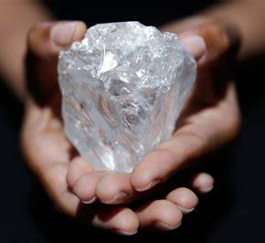
So, why diamonds?
Because they’re pretty!
Notes:
World’s largest diamond to date. Botswana, size of a tennis ball, 1109 carats. Valued at $70 million dollars.

Slide 20
References
https://msestudent.com/diamond-cubic-unit-cell/
https://www.smithsonianmag.com/science-nature/diamonds-unearthed-141629226/
https://tukutivojur.maghreb-healthexpo.com/properties-of-allotropes-of-carbon-essay-32189lq.html
https://www.npr.org/sections/goatsandsoda/2016/06/29/483695466/botswana-s-economy-needs-more-than-diamonds-to-shine
https://www.today.com/style/why-diamonds-story-behind-engagement-rings-you-never-knew-t100949
https://www.diamonds.pro/education/clarity/
https://www.diamonds.pro/education/carat-weight/
https://en.wikipedia.org/wiki/Synthetic_diamond
https://www.etsy.com/listing/457202148/ouroboros-snake-ring-in-sterling-silver

