Slide 1
12
mar
19
2024
An AMAZING
Presentation!
Materials
Science
(part 1)
made by
Maddy selby

Slide 2
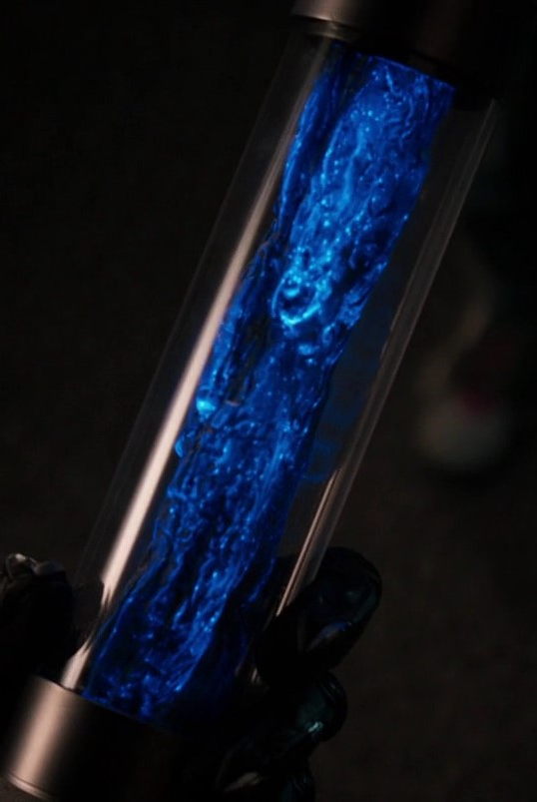
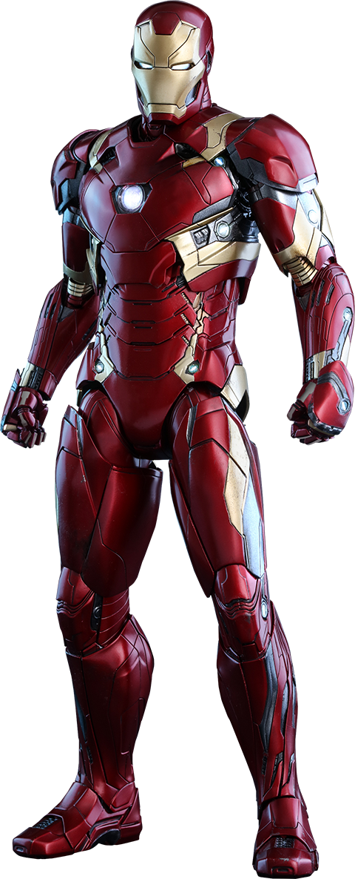
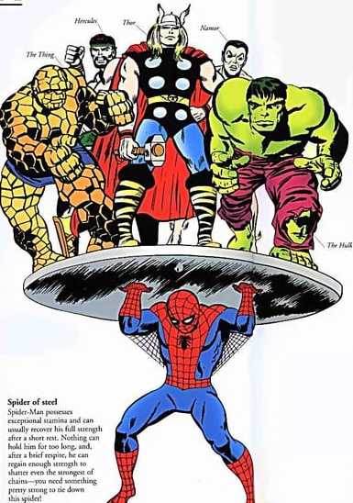
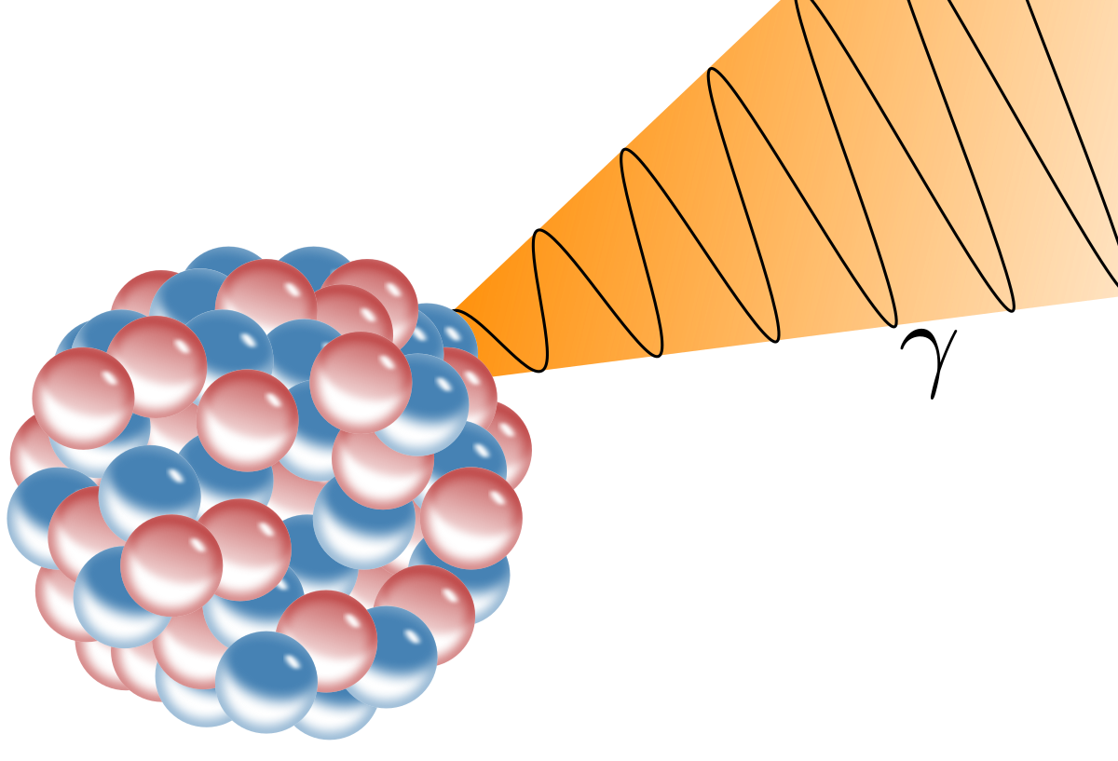
Coolest marvel materials and engineering
Vibranium
Iron man suit
Spider-man strength
Hero origin stories
Super strong fictional metal
I want one
Is he strong? Listen bud: he’s got radioactive blood
Gamma rays, serums, and 3d printing a body, oh my

Slide 3
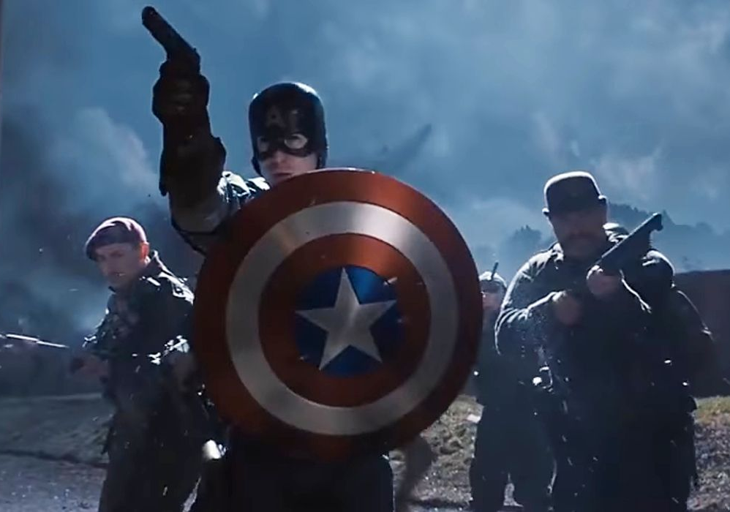
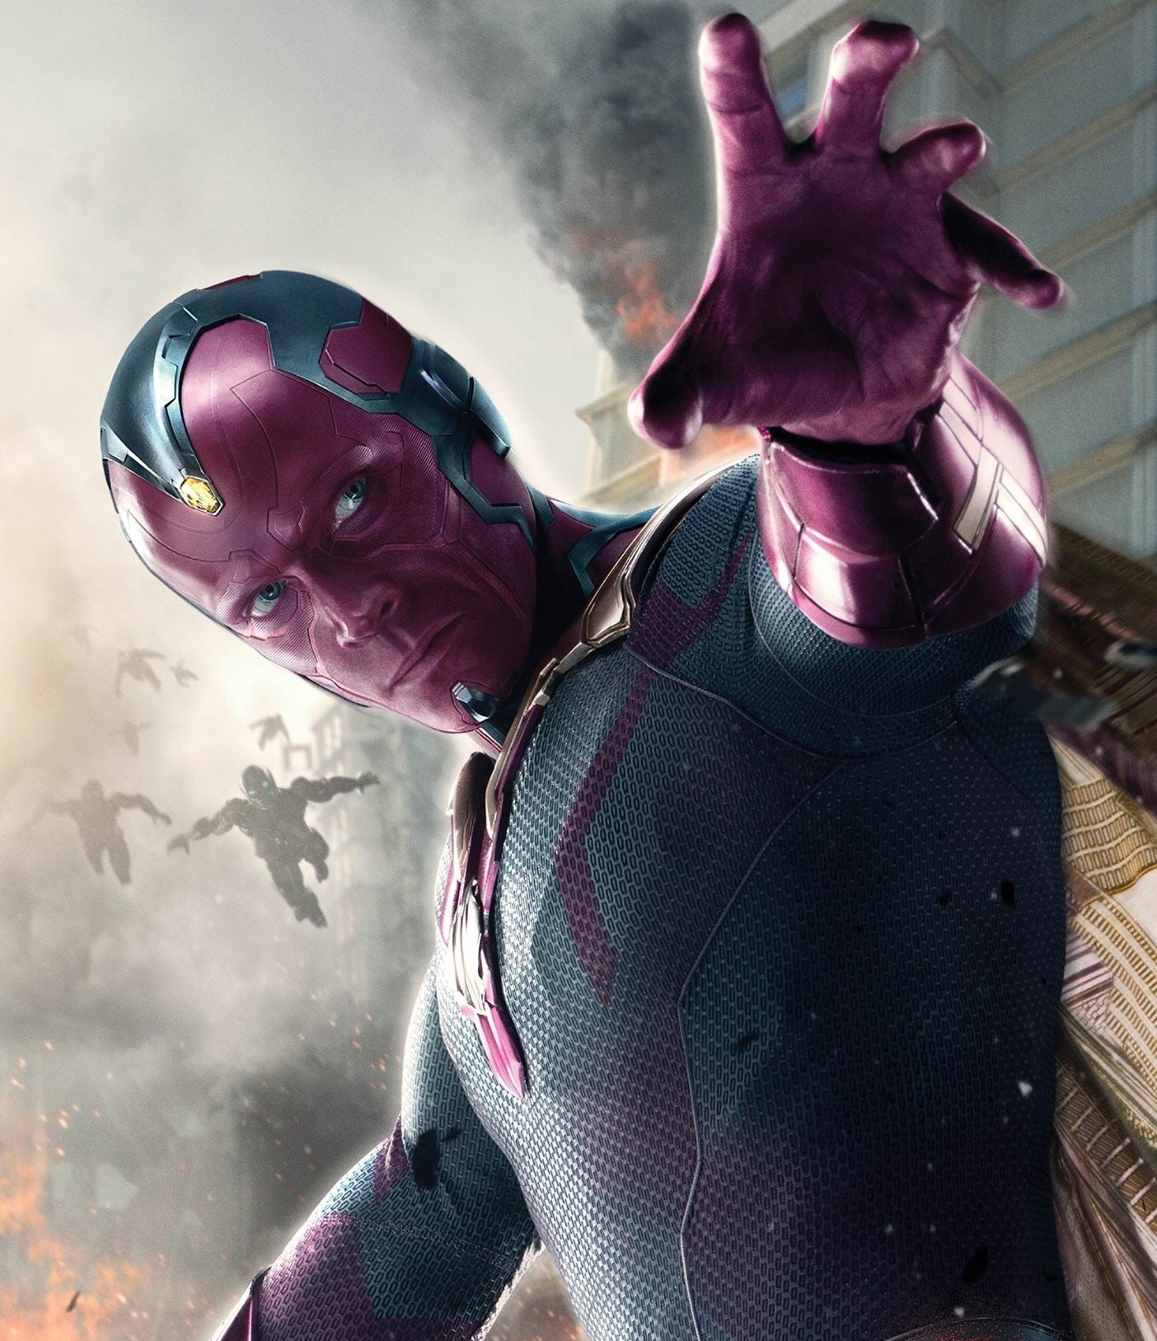
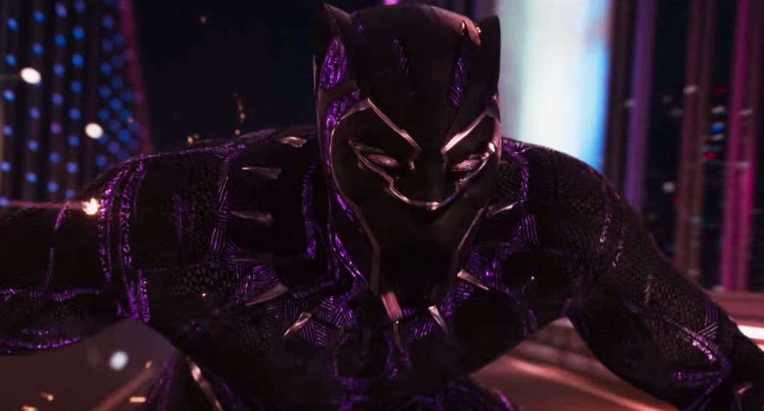
What is Vibranium?
Captain America
According to marvel
Material that absorbs kinetic energy and stores it in its bonds
More energy absorbed = stronger molecular bonds Stores energy and releases it as needed
1/3 density of steel (1018 steel is 7.86 g/cm³)
Can be forged, woven, bonded to cells
Used to make Captain America’s shield, black panther’s suit, vision’s body
“completely vibration absorbent” – a lie
vision
Black panther
According to maddy
Vibranium’s density is 2.62 g/cm³
Energy damping possibilities – applications in defense world
Notes:
https://www.cbr.com/dark-secrets-black-panther-suit/

Slide 4
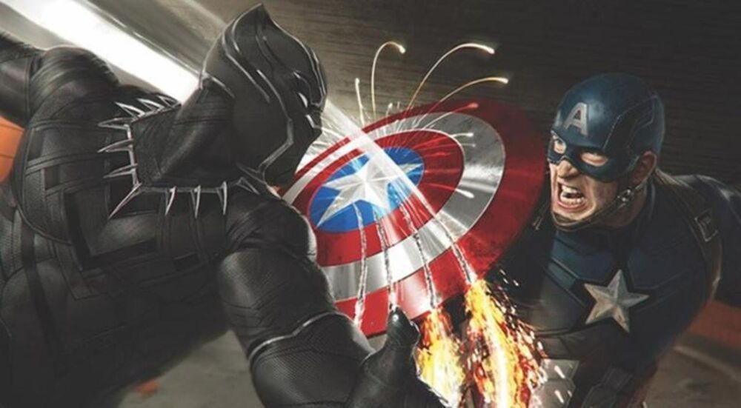
Case study on cap’s shield
Black panther v. Captain america
Marvel says it’s Antarctic Vibranium which can “cut through any metal at a molecular level”
sound of impact
No recoil of the shield
Antarctic Vibranium “has the ability to emit vibrations that cause the molecular and atomic bonds of nearby metals to slowly breakdown”
Vibranium on Vibranium leaves scratches
Higher purity?
Different grain orientations? Maybe Wakanda has more refined manufacturing methods than the usa in the 1940s?
Heat treatments?
If We’re going to sample prep Vibranium to test it, we’re going to somehow need to develop a method to make Antarctic Vibranium a sandpaper and hope to never sample prep Antarctic Vibranium
Massive energy release
two unbreakable materials collide
Notes:
https://www.cbr.com/black-panther-claws-anti-metal-antarctic-vibranium/

Slide 5
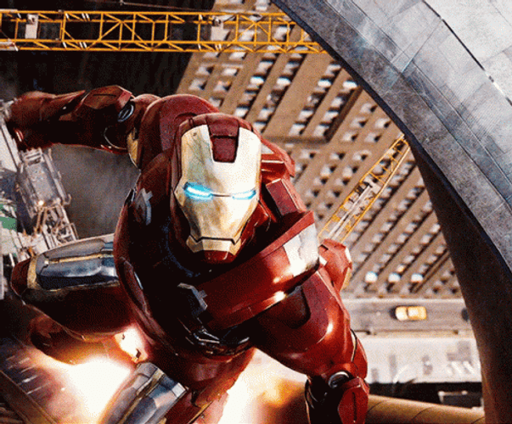
iron man suits
Mark II suit: chromed titanium-steel alloy
Mark iii suit: Gold-titanium alloy
Tony stark says this alloy change will help with ice forming on outside at low temps while maintaining power to weight ratio – is it true???
thermal conductivity at 0°C (W/mK)
Steel: 54
Gold: 318
strength
Gold (β-Ti₃au cubic structure): hardness 4 times pure ti and most steel
Density
Steel: 7.9 g/cm³
Gold (β-Ti₃au ): 8.5 g/cm³
Notes:
https://www.engineeringtoolbox.com/thermal-conductivity-metals-d_858.html
https://www.ncbi.nlm.nih.gov/pmc/articles/PMC4956191/

Slide 6
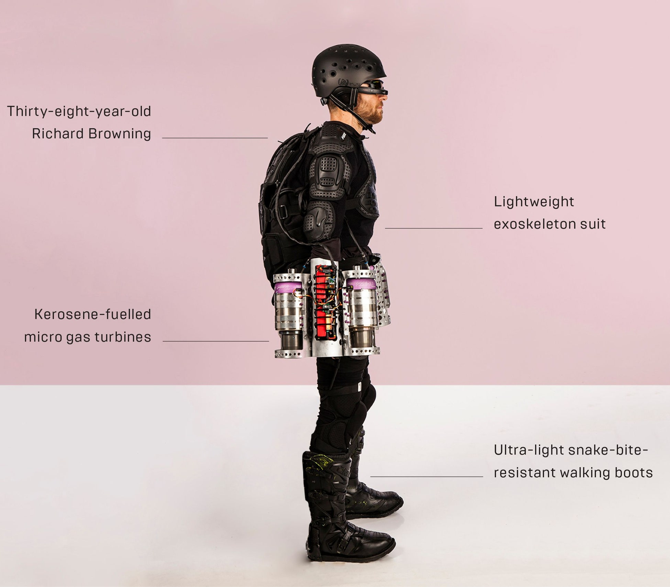
Hemker group field trip?
Flight experience:
$3500+tax
1 flight sessions
Flight training:
$6600+tax
2 flight sessions
2019 record of 85.06 mph
fastest speed in a body-controlled jet engine powered suit
Add in a better version of the apple vision pro and we’re almost there!
How can I get an iron man suit?

Slide 7
Hemker group field trip?
Flight experience:
$3500+tax
1 flight sessions
Flight training:
$6600+tax
2 flight sessions
How close are we?

Slide 8
Spider-man’s strength is proportional to that of a spider
Spiders can lift 10-170 times their own weight, depending on species
Therefore, if spider-man weighs 200lbs, that would be a max weight of 2000-34000 lbs
Let’s see if that’s true in the comics/movies!

Slide 9
Different spider-man strengths
The original
Tobey Maguire
Andrew garfield
Tom holland
(1960s comics)

Slide 10
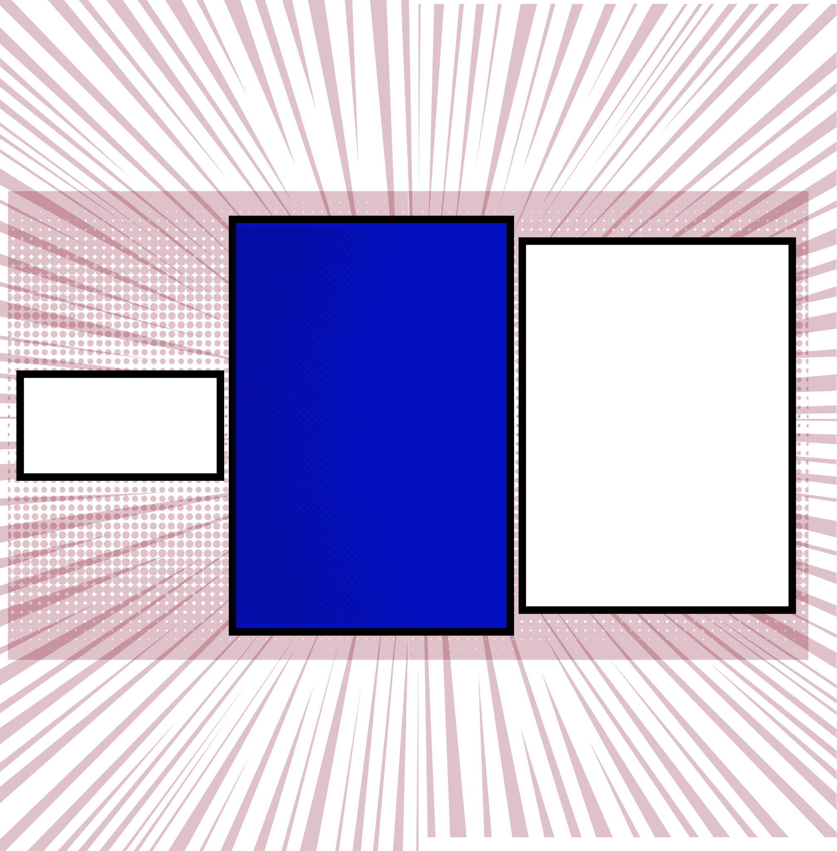
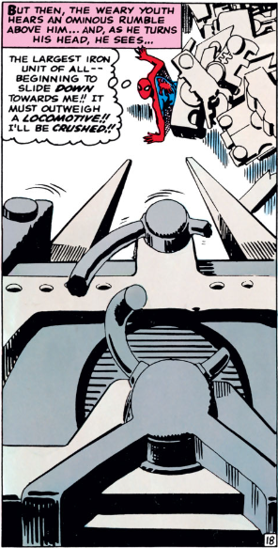
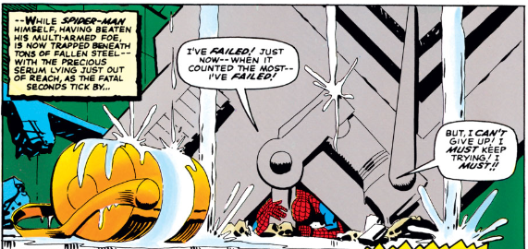
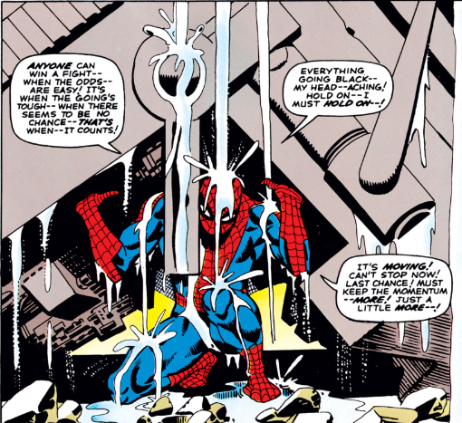
Issue #33
Let’s call spider-man 6ft tall
The area he’s trapped under is 3ft tall, making one dimension of structure 18ft
If he can lay fully under it and not consider backing out, that’s 10ft
Let’s guess that it’s 30ft in the last dimension
18 ft
3 ft
Topic 3
20 ft
3 ft
18 ft
3 ft
10 ft
The original
(1960s comics)
4 ft

Slide 11
Issue #33
Let’s call spider-man 6ft tall
The area he’s trapped under is 3ft tall, making one dimension of structure 18ft
If he can lay fully under it and not consider backing out, that’s 10ft
Let’s guess that it’s 15ft in the last dimension
18 ft
3 ft
Is it iron or steel? if we assume medium/ low carbon steel is what spidey meant to say, 1018 has a density=0.284lb/in³
Not solid, so ½ dense
Topic 3
20 ft
3 ft
18 ft
3 ft
10 ft
The original
(1960s comics)
$$density∗volume=\frac{0.284lb}{{in}^{3}}∗\frac{{\left(12in\right)}^{3}}{{ft}^{3}}∗\left(18ft\right)\left(10ft\right)\left(15ft\right)(0.5)$$
$$=662,515 pounds=331 tons$$
1960s locomotive weighs 100-150 tons
4 ft
Spider ratio says max 34,000lbs

Slide 12
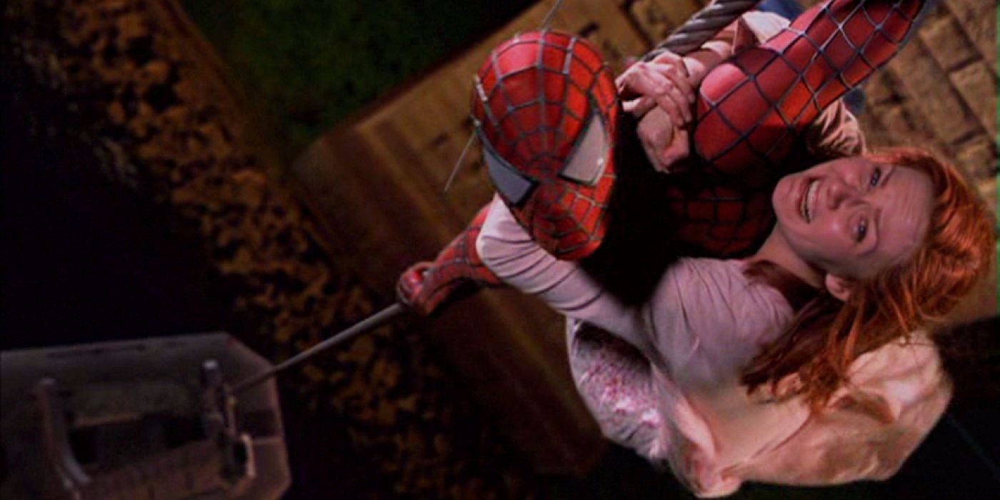
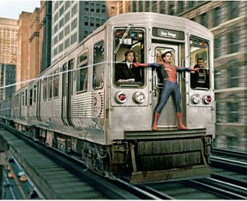
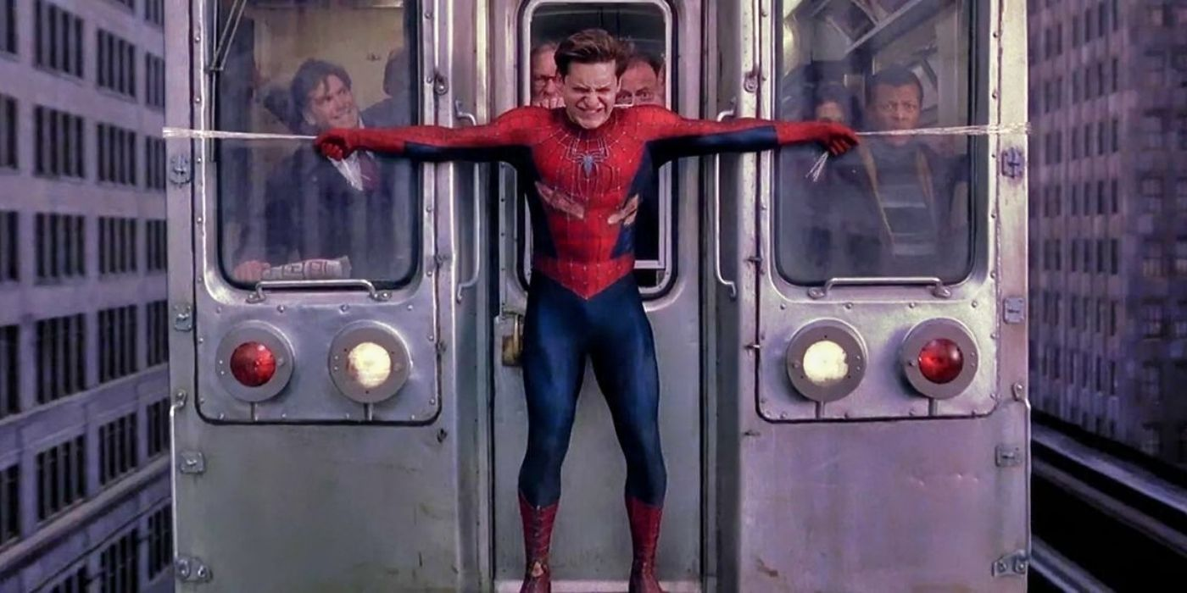
Spider-man
According to Roosevelt island stats, a cable car is 41,525 lbs when fully loaded and 22,125 lbs when empty
Maybe if the car isn’t fully loaded this would be reasonable for spidey
Topic 3
Average nyc subway car is 60ft long, 10ft wide
Weight per car: 85,000 lbs
Average train has 8-10 cars
Total train weight is 850,000 lbs
Max speed 55 mph
Seems unlikely to me
Tobey Maguire
Spider ratio says max 34,000lbsz

Slide 13
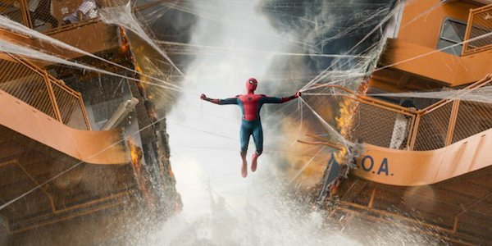
Next time…
Topic 3
Tom holland

Slide 14
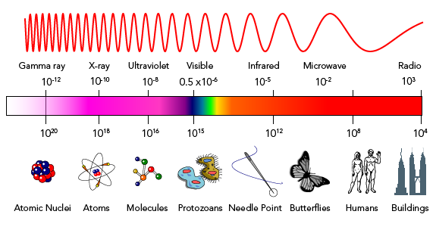
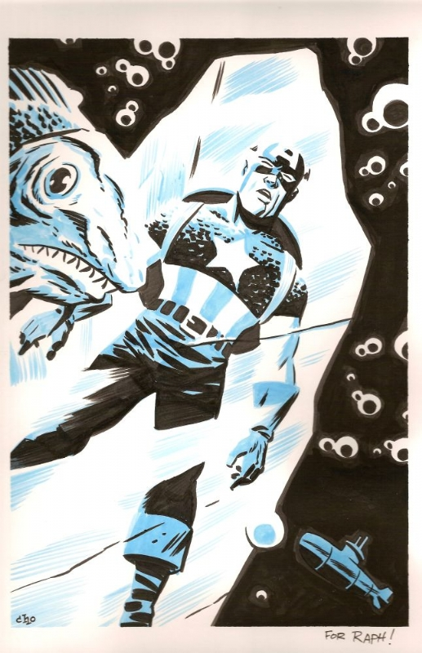
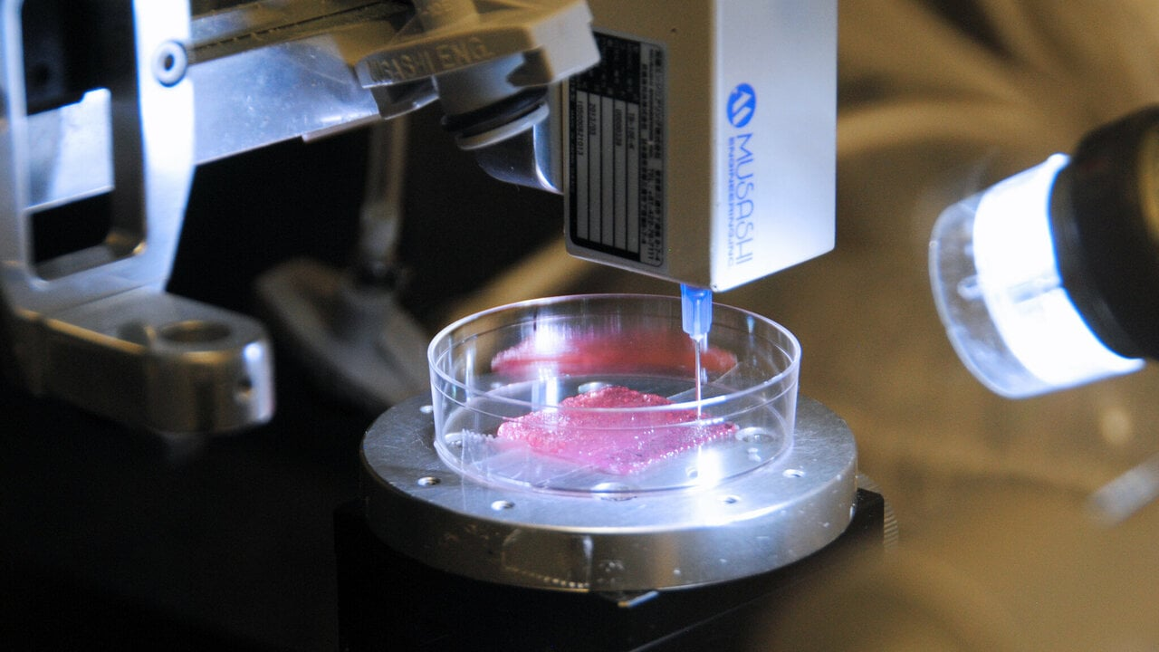
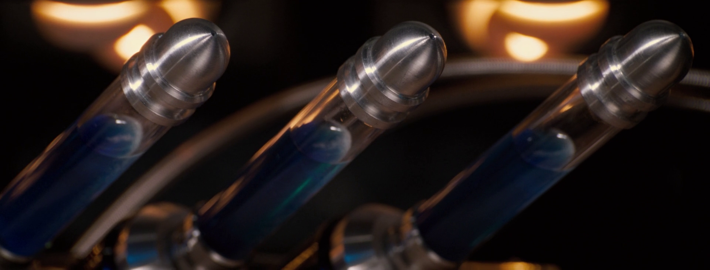
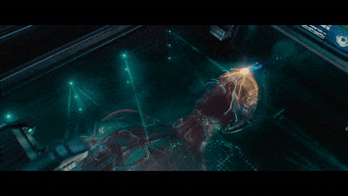
Superhero origin stories
Movie hulk experienced a dose of 85 gy
Max gamma radiation before death is 6 gy
Hulk should have instantly died, not turned green and strong
Somehow increases metabolism enough to survive being frozen for decades?
progress!
Gamma rays
Super soldier serum
Printing vision a body
High dosage causes mutations?
To enhance the body and mind
Fusing Vibranium to cells for 3d printing
death
Notes:
Can you survive being frozen? What would it take?

Slide 15
Thank you!
(part 2 to come)

